Slide 1

Gender balance at IPSL
Béatrice Marticorena (LISA)
SAB - 27 June 2023

Slide 2
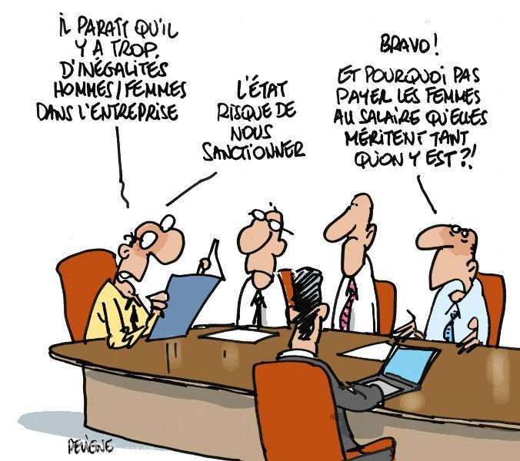
Why bother with gender balance?
A matter of of fairness/equity, human rights ?
A major engagement of the French President’s first mandat 2017-2022
A legal obligation = since 2019, all French public institutions must have an action plan on parity and equality
Long lasting efforts ( more than 20 years):
- « Irène Joliot-Curie Price » from the Ministery of Research
- « Mission pour la Place des Femmes » in CNRS

Slide 3
Gender Balance in the French Universities
Permanent Research/Teaching Staff
in the Universities in 2020
60 % Men
40 % Women
% Assistant Professor
% Professor
Proportion of women Research/teaching in the Universities
From 1992 to 2020
Assistant Pr : + 17 pts
Professors : + 10 pts
12%
35%
29%
45%
(Enseignement Supérieur, Recherche et Innovation, Vers l’égalité femmes-hommes ? Chiffres Clés ; 2022 MESRI)

Slide 4
Gender Balance for STEM (Science, Tech., Eng., Math.)
Proportion of women scientists
in research institutions by disciplins in 2020
Proportion of research/teaching women
in the Universities by disciplins in 2020
% Women
% Women
Chemistry
Agronomy and food
Chemistry
Science of the Universe
Earth Science
Physics
Mathematic, computing
Engineering
Physics
Engineering
Mathematic, computing
(Enseignement Supérieur, Recherche et Innovation, Vers l’égalité femmes-hommes ? Chiffres Clés ; 2022 MESRI)

Slide 5
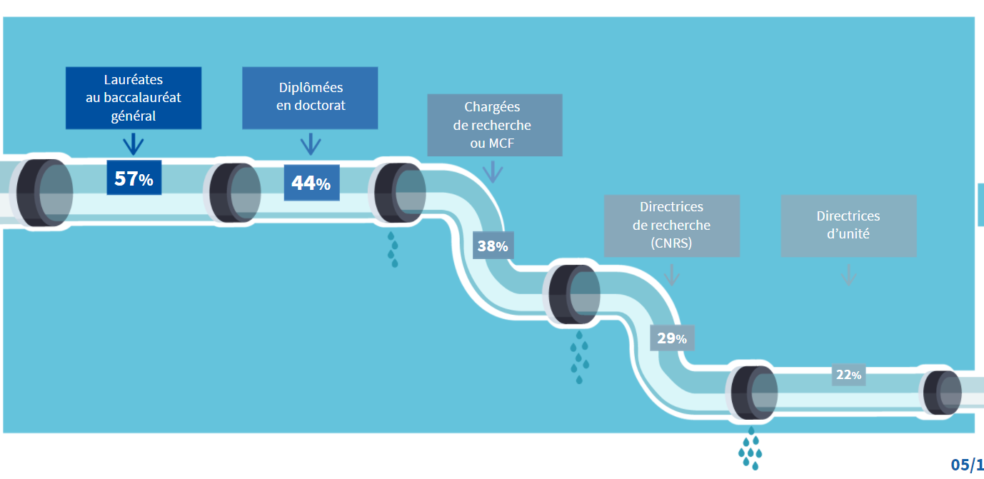
Gender balance at CNRS
The leaky pipe = a process of progressive exclusion
High school
PhD
Junior Scientist
Senior Scientist
Lab Director
(Figure from the CNRS formation on stereotypes)

Slide 6
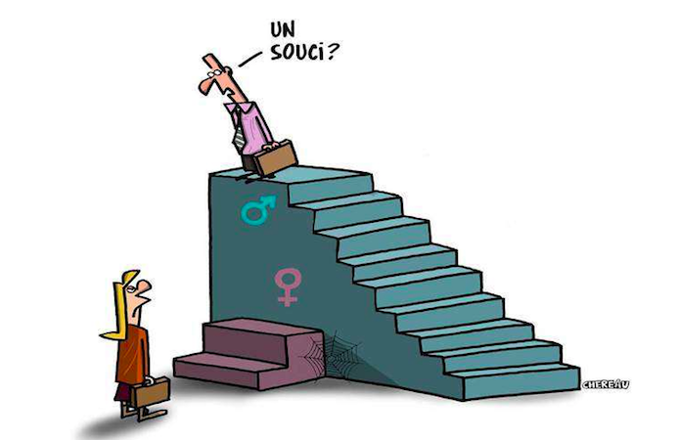
Gender Balance at CNRS
A problem ?
The glass ceiling effect
Proportion of men and women for the different CNRS Instituts
DR Men
DR : Senior Scientist
CR : Scientist
CR Men
DR Women
CR Women
Men advantage Index
[DR/(DR+CR)]_{men} / [DR/(DR+CR)]_{women}
Biol.
Chem.
Ecol.
Soc. Sc
Num.
Ing.
Math.
Phys.
Nucl.
Sci. Univ.
https://drh.cnrs.fr/le-rapport-social-unique/
Année 2020

Slide 7
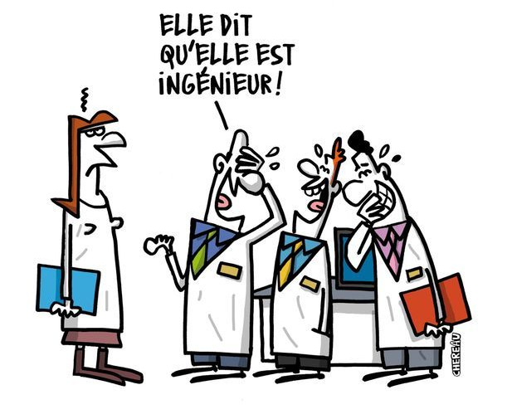
Gender Balance at CNRS
She says she is engineer !
% Women
Increasing grade (Salary)
Proportion of female engineers and technicians
+ the glass wall effect
https://drh.cnrs.fr/le-rapport-social-unique/
Année 2020

Slide 8
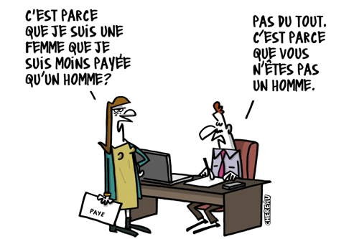
General observation
The % of women decreases continuously from the graduation level to the highest level of responsabilities.
The effect is even more pronounced for STEM sciences
The impact on the carreer and the salary of women is clear for scientist and technicians
No. It is because you are not a man.
The main processes :
- Stereotypes
- Bias (un-conscious)
Is it because I’m a woman that I am less paid ?

Slide 9
The CNRS Action Plan (2021-2023)
https://mpdf.cnrs.fr/roadmap/
Assessment, prevention and reduction of the salary differences
Garanty of equal access to the different grades and jobs
Equilibrium between professional life and personnal/family life
Prevention and fight against sexual and gender-based violence, harassment and discrimination
Governance of the professional equality policy
_ The same axis for all national organisms (including Universities)

Slide 10
Implication for the IPSL
Diversity of status and involved organisms : 8 labs and 1 FR
    CNRS
    Several other institutions (ENS, Polytechnique, CEA , ENPC ..)
    Several Universities
The organisms acts as employers or as hosting institutions.
They all have their own action plans !
= Overlaps/redundancy on some points
= Discrepancies on others ..
= Need for consistency and coordination

Slide 11
Gender balance at IPSL

Slide 12
Gender balance at IPSL
TOTAL (including non permanents, and PhD)
M
W
%W
Number of people
1190
42,2 % of women

Slide 13
Gender balance at IPSL
Scientists (DR, CR, MC, Pr)
(CNRS, Univ, CEA, EDF , etc..)
Number of people
448
38 % of women

Slide 14
Gender balance at IPSL
Senior: 34 % of women
(Pr, DR, Phys., As)
Junior : 42 % women
(EC, CR, Phys.Adj, As.Adj.)
M
W
%W
M
W
%W
LSCE : 28 EPIC : 39,9% F; CEREA : 23 EDF, 34,8% F

Slide 15
Gender balance at IPSL
Male advantage index: [Rang A/(Rang A+ Rang B)]_{Men} / [Rang A/(Rang A+ Rang B)]_{Women}
Men
Women
Advantage Index
AI >1 = Male Advantage
AI <1 = Female Advantage

Slide 16
Gender balance at IPSL
Permanent Technical staff
41,5 % of women
Increasing grade

Slide 17
Gender balance at IPSL
Non permanent positions
Contract + PostDoc
43,3 % of women
PhD
44,3 % of woman

Slide 18
Concluding remarks
The gender balance of IPSL is in the same range or slightly better that in the community
It varies according to the labs, mainly due to differences in the status (Univ/CNRS/..)
Technical staff : the higher % of women are in low classes
The gender balance of PhD are in the same range than in the community : to be maintained up to the position applications !
The lab directors are all men !

Slide 19
Action plan at IPSL
A good frame to share and compare the situations and the experiences
  - Comparison between labs : use of quantitative and comprehensive indexes; differences due to the status
  - Sharing good practices (Internal charters)
Communication
- Highlighting women’s carreers (all jobs and disciplins)
  - Vector of inclusive communication (announcements, job and PhD offers)
Education
  - Raising awareness in Master and PhD cursus ?
  - Mentoring for PhD and young scientist ?

Slide 20
The next Challenge
From Gender balance to « Inclusion »

Slide 21

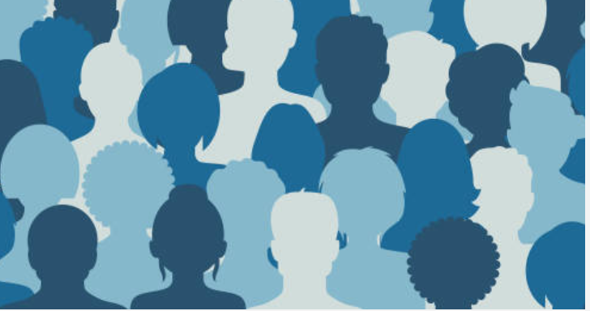
Thank you
for your attention

Slide 23
Diggest (partiel) of observed bias
Systematic asymetry starting at school
Girls works more/boys are (naturally) good
Girls do not « choose » science
Stereotype threat
Unconscious bias inconscients (implicit associations)
Male standards of success
Men : elective fonctions; femmes = administrative fonctions (dusty work)
Double parenthood standard
Impostor syndrome
Academic life cycle
Post-docs : less and less women with time
CNRS application : Less women, decreasing % with age; Unconscious bonus to men
Oral presentations : Women are more frequently interrupted; More assertive questions + criticism
Impact of evaluator gender ? Resistance to the proof, denial
Peer Review
Tougher scrutiny for female authors; Women are less cited.
Stronger homophilia among men in editorial responsibilities
« Matilda effect » : women get less credit for their work than men
(From a synthesis produced by the « Mission pour la Place des Femmes du CNRS », M. Arbogast)

Slide 24
EXAMPLES of actions taken by the CNRS
« Parity-Egality » referents in the CNRS committes for recruitment and promotions for scientists.
Recommendation to respect the percentage of promouvable women for promotion, the percentage of female candidates for recruitement.
Signature of a charte for a communication with no sterotypes.
Parity in the scientific events (recommandation CS): the CNRS is not associated if women are not presents at all levels (scientific comittes, organisation comitee, invited talk..) in the same proportion than in the domain.
Creation of an on-line formation (biais and stereotypes) of the members of committes and the labs’ directors.

Slide 25
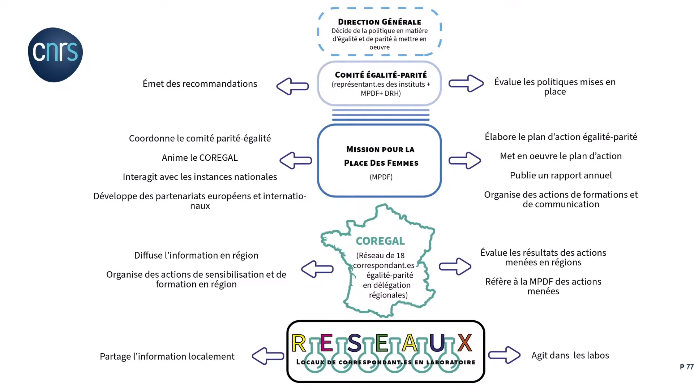
Direction
decides the policies
Makes recommendations
Committee for Parity-Equality
Evaluates the policies and the actions
B. Marticorena (INSU), J-L. Vercher (INSB)
Coordinates the Committee for Parity-Equality
Animates of the COREGAL
Interacts with national instances
Develops european ans internatioanl partnerships
Mission for the place of women (MPDF)
Defines and deploy the action plan
Produce the annual report
Organises formation and communication actions
Distribute information in the regions
Organise formation and awareness activities
Evaluate local actions
Reporting to the MPDF
Focal points in the regional delegations
Share and spread information
Actions in the labs
Reference people in the labs

Slide 26

Coordination Parity-Egality in the Universities
https://www.cped-egalite.fr/cped/

Slide 27
Effectifs CR et DR CNRS-INSU
Rapport DR/CR :
  0,82 à 1,17 pour les hommes
  0,55 à 0,83 pour les femmes
Indice d’avantage masculin :
De 2009 à 2019 :
baisse de 1,5 à 1,41
= 0,1 point/10 ans
Selon la tendance y = 1 en 2060
(CR du CSI de l’INSU du 14/04/2021)

Slide 28
Effectifs CR et DR CNRS par section
CR : 37 à 45 %
DR : 30 à 38%
DR : 21 à 27%
CR : 18 à 20%
- % de CR > %DR
% CR ET %DR en augmentation
Ecart constant
- % faibles en CR
mais %DR>CR
%DR en augmentation
%CR stable
(CR du CSI de l’INSU du 14/04/2021)

Slide 29
 |  | Ecart 2019-2009 | Femmes | Hommes
Total | DR CR | 80 -92 | 36 (45%) -15 (16%) | 44 -77
S 17 | DR CR | 17 -27 | 5 (29%) -4 (15%) | 12 -23
S 18 | DR CR | 33 -51 | 16 (48%) -19 (37%) | 17 -32
S 19 | DR CR | 36 -7 | 15 (41%) 5 (++) | 21 -12
Extra | DR CR | - 6 - 7 | 0 (0%) +3 (++) | -6 -10
Evolution des effectifs
CNRS-INSU
sur 10 ans
 |  | Effectifs 2019 | Femmes | Hommes | Ecart H-F | Ecart à 50%F
Total | DR CR | 489 459 | 129 (26%) 155(34%) | 357 (73%) 304 (66%) | 228 149 | 114 74
S17 | DR CR | 152 139 | 38 (25%) 27 (20%) | 114 (75%) 112 (80%) | 76 85 | 38 42
S 18 | DR CR | 170 152 | 39 (23%) 54 (35%) | 131 (77%) 98 (65%) | 92 44 | 46 22
S 19 | DR CR | 149 150 | 49 (33%) 65 (43%) | 100 (67%) 98 (57%) | 51 33 | 25 10
Extra | DR CR | 15 18 | 3(20%) 9(50%) | 12(80%) 9(50%) | 9 0 | 5 0
(CR du CSI de l’INSU du 14/04/2021)

Slide 30
Situation générale dans le milieu académique EU
(Enseignement Supérieur, Recherche et Innovation, Vers l’égalité femmes-hommes ? Chiffres Clés ; 2022 MESRI)
https://www.enseignementsup-recherche.gouv.fr/fr/vers-l-egalite-femmes-hommes-chiffres-cles-84053

Slide 31
Situation générale dans le milieu académique EU
50 %
(Enseignement Supérieur, Recherche et Innovation, Vers l’égalité femmes-hommes ? Chiffres Clés ; 2022 MESRI)

Slide 32
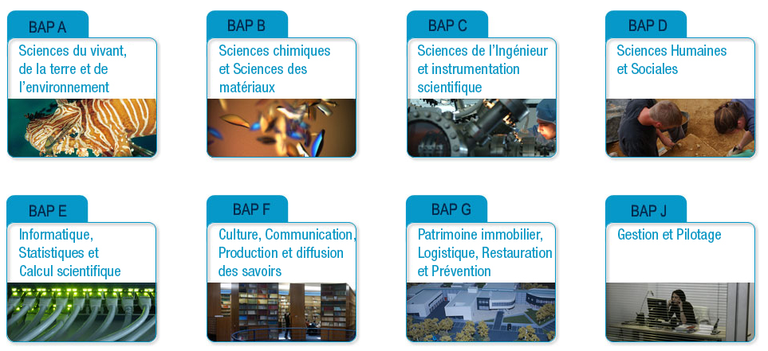
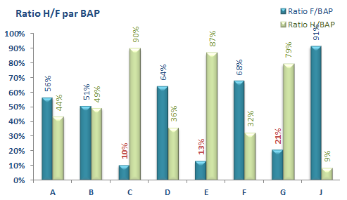
Situation générale au CNRS
Les parois de verre
% Women
Les femmes ITA occupent majoritairement des emplois dans l’administration, la documentation, et pour les BAP support scientifique, elles sont plus particulièrement présentes dans les SHS. Pour toutes les BAP dites « sciences dures », les hommes sont majoritaires.
Effectifs ITA par BAP (enquête DR17)
https://drh.cnrs.fr/le-rapport-social-unique/
Année 2020

