Slide 1
SSO in LMDz, « en route » toward DYNAMICO
Runs presented,
SSO variables calculated using
1) Spherical harmonics and « telescopique filter »
2) Conventionnal « grid_noro »
Input data for all runs : 10' topo
Same SSO parameters as in CMIP
SST-sea ICE period 1980-1985

Slide 2
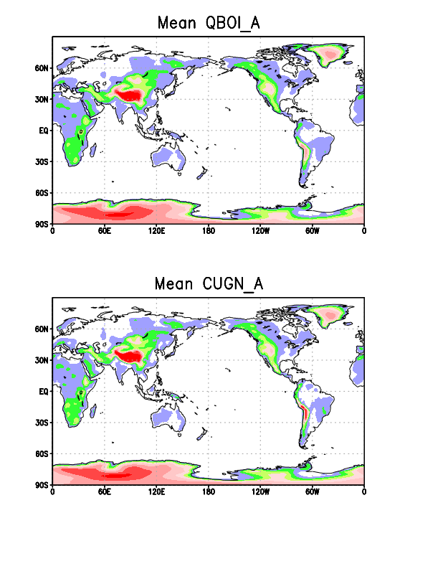
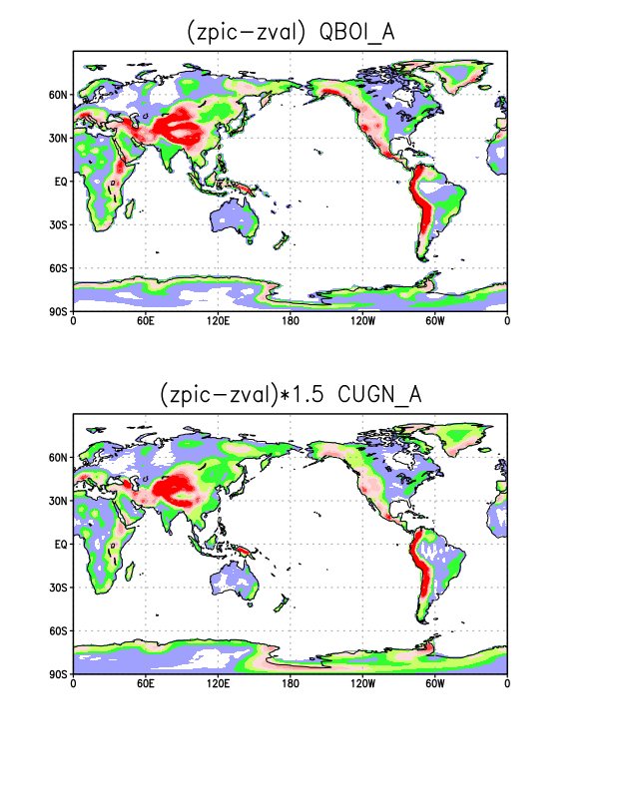
SSO Parameters:
Mean is good
Our evaluation of zpic & zval from
std. dev, underestimate the
difference by 50 %

Slide 3
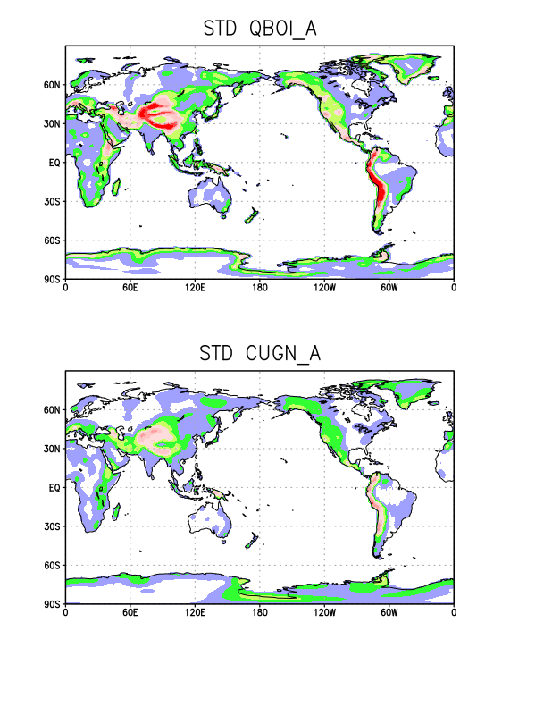
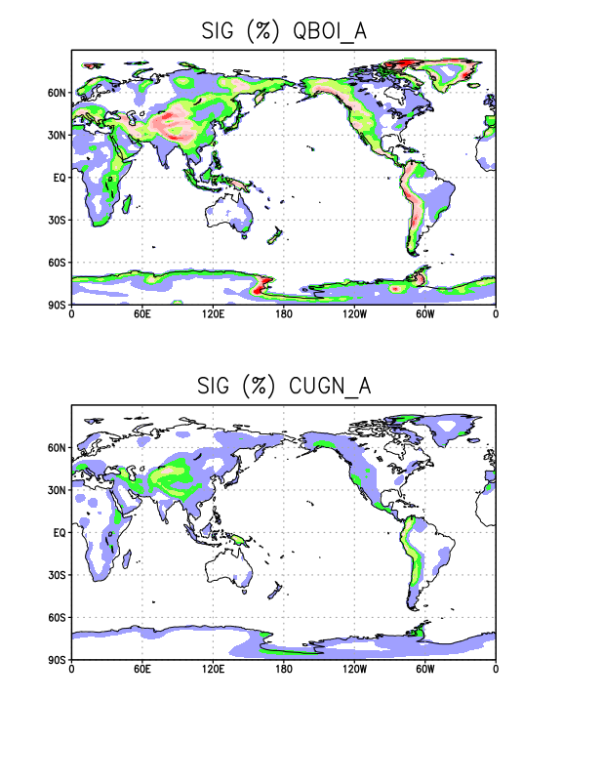
SSO Parameters:
Std devs and slope are underestimated again, note how large values in the
polar regions have been smoothed out by the telescope technique...
Mean is good

Slide 4
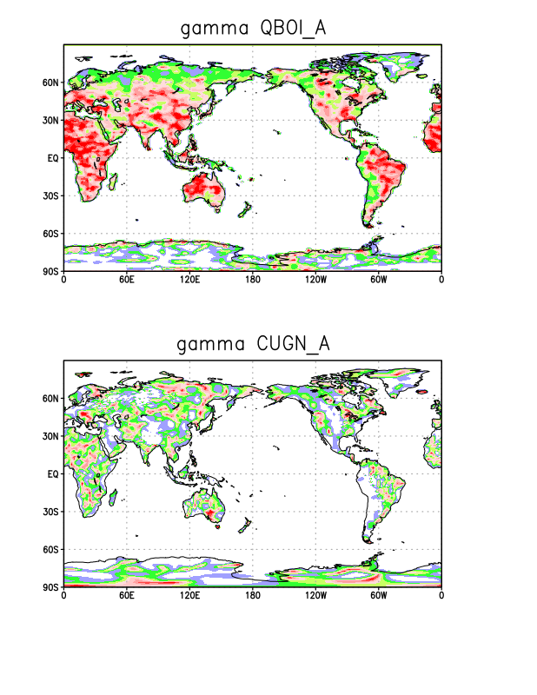
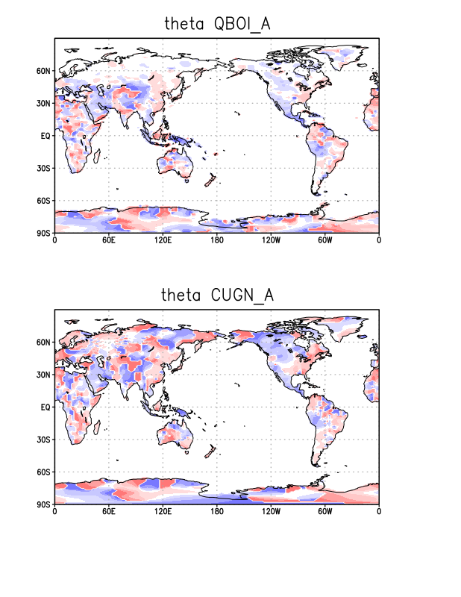
SSO Parameters:
Gamma (no comments) and Theta ;

Slide 5
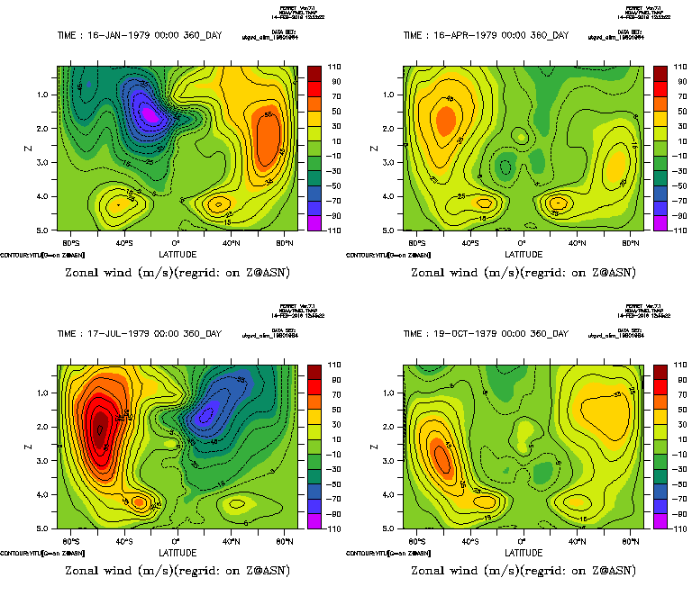
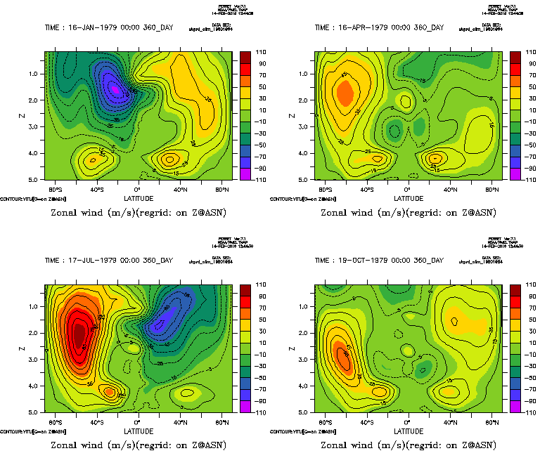
Zonal mean zonal winds
CUGN_A
QBOI_A

Slide 6
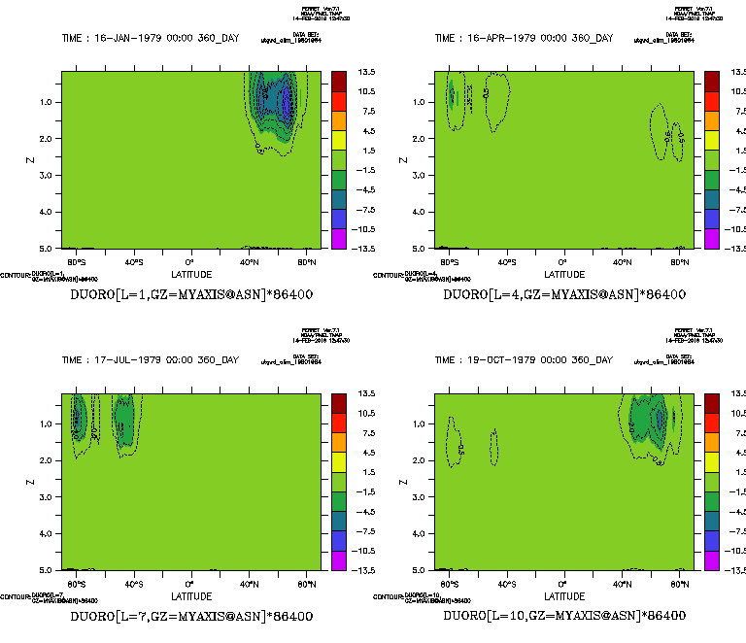
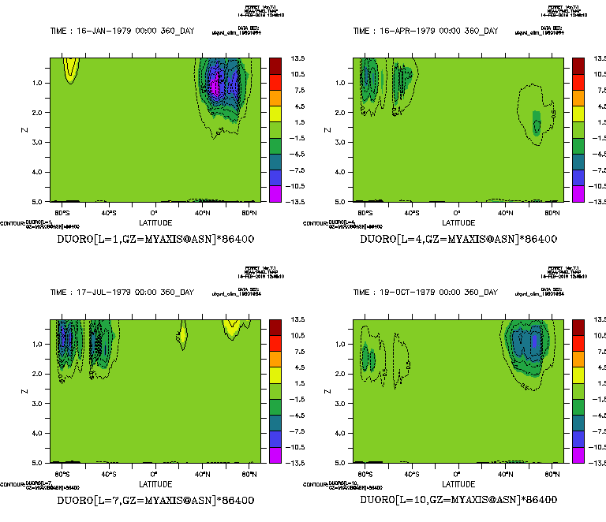
Zonal mean SSO zonal drag
CUGN_A
QBOI_A

Slide 7
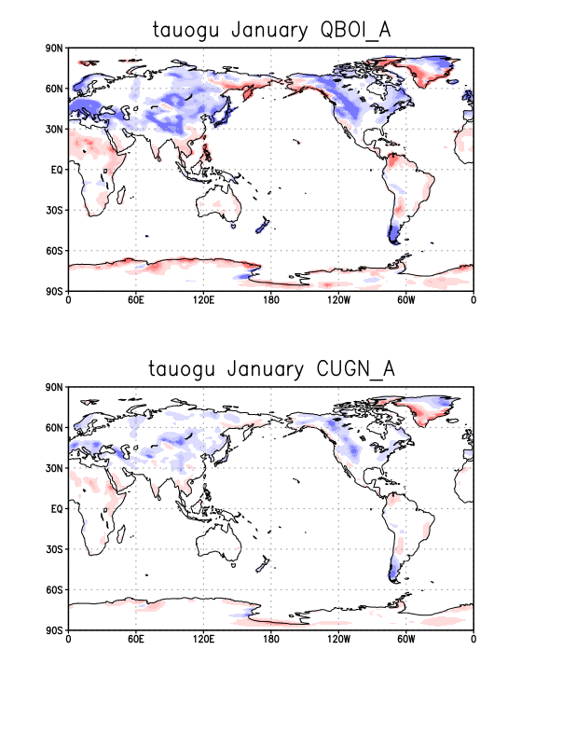
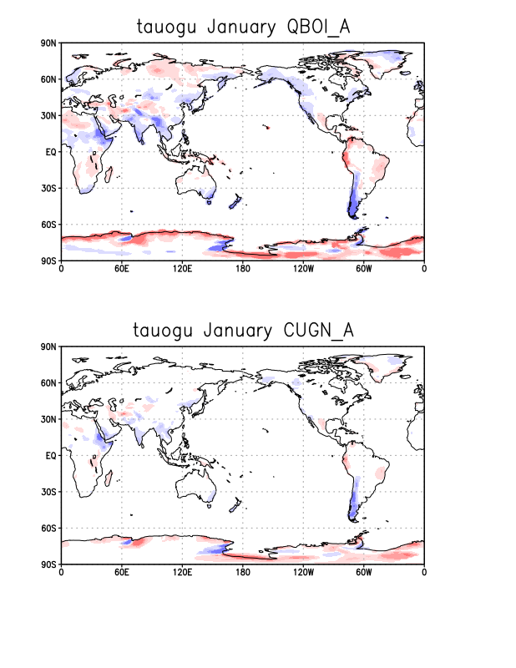
Surface zonal stress
January
July

Slide 8
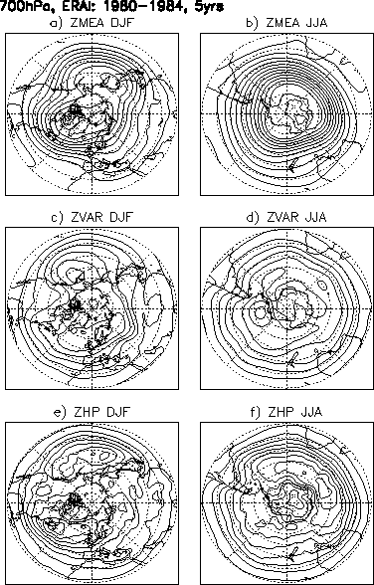
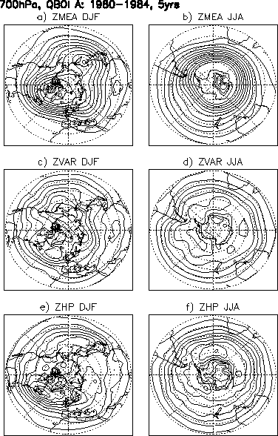
700hPa diagnostics, NH and SH Winters (DJF and JJA)
1980-1984 Period
ERAI
LMDz, CMIP6
LMDz, New SSO
parameters
Mean
Std Dev
Hi Pass
Std Dev

Slide 9
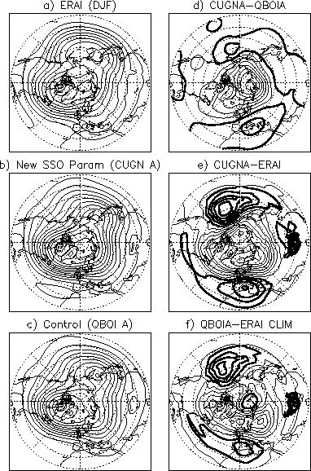
Steady planetary wave :
some tuning needed, but let's wait the next SSO database

