Slide 1
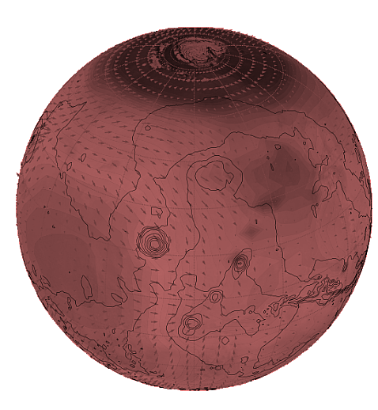
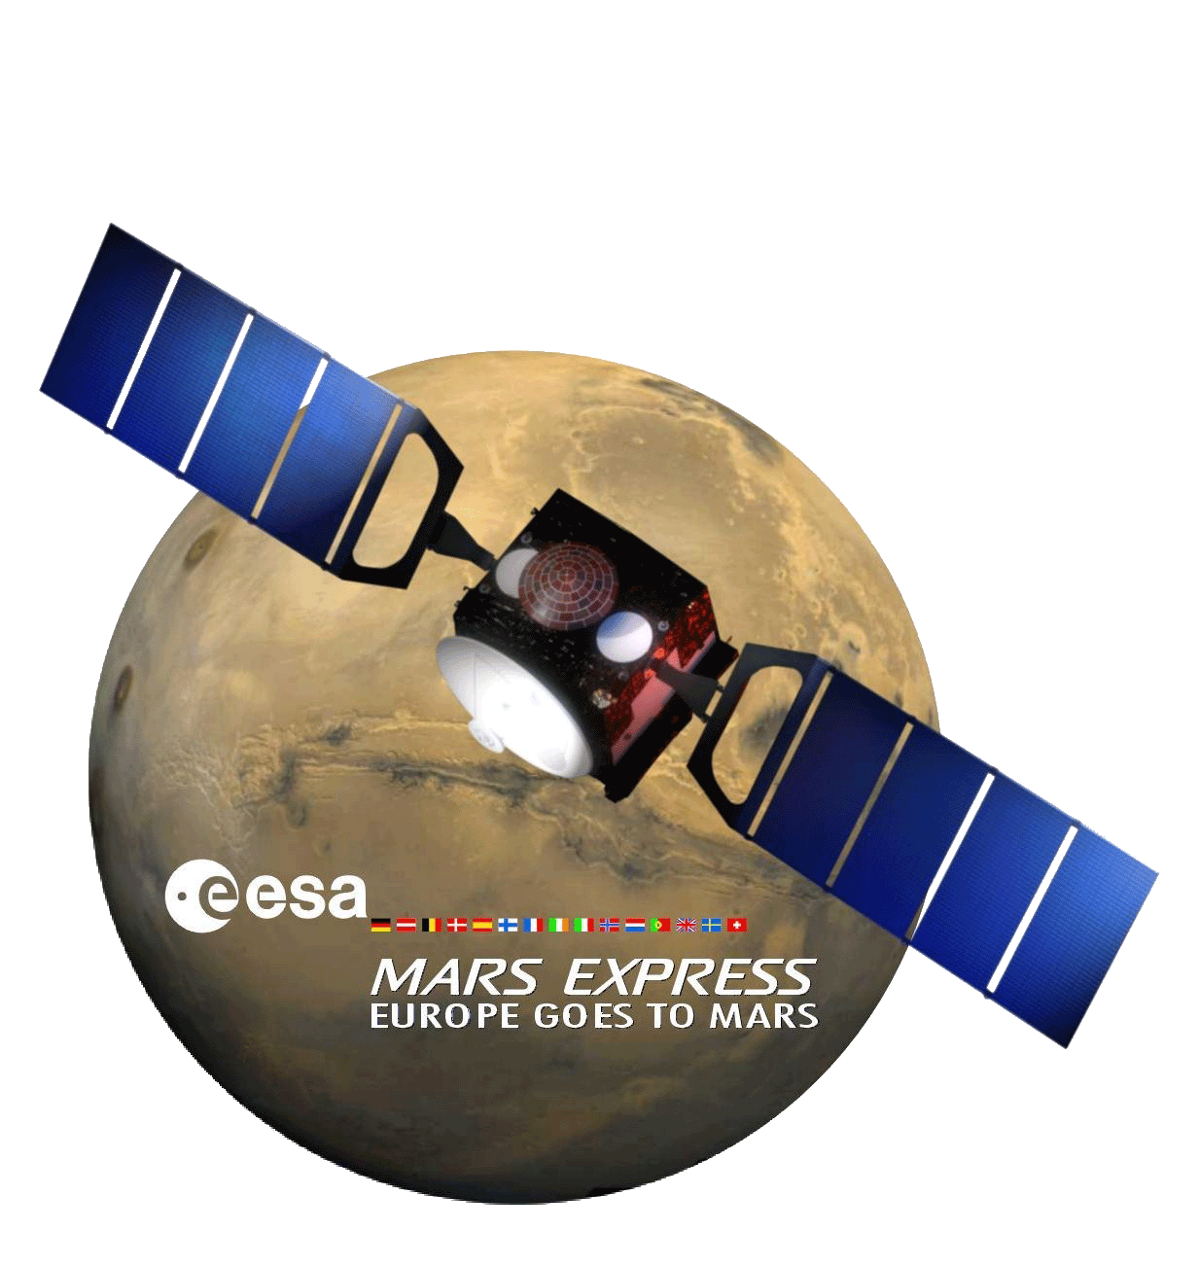
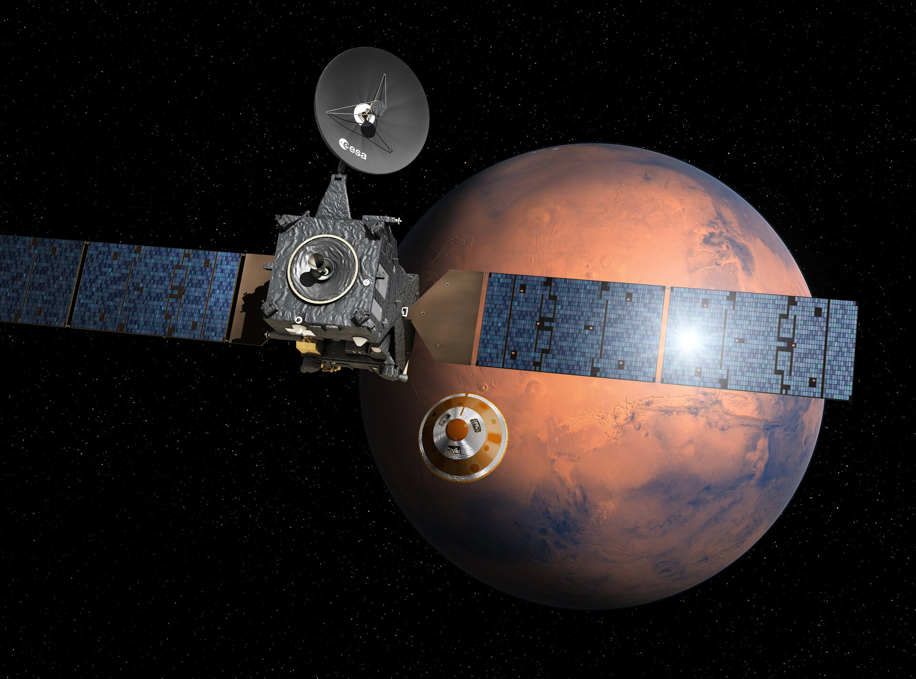




Deciphering Mars’water cycle with missions and models
Franck Montmessin
CNRS LATMOS, Guyancourt (Fr)

Slide 2




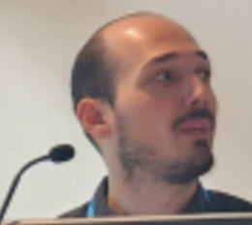

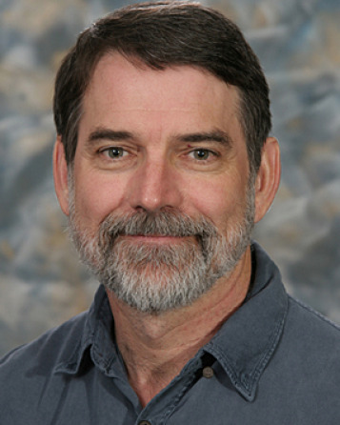









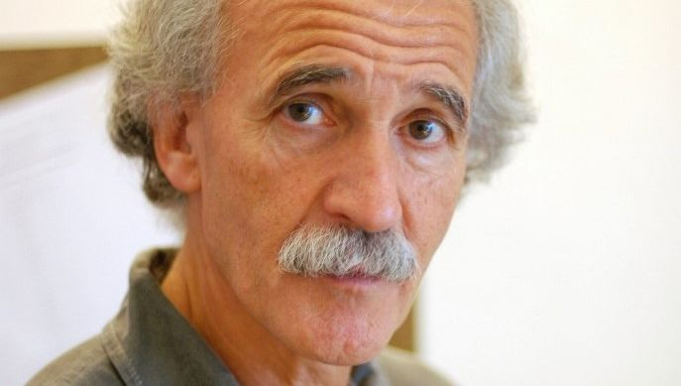

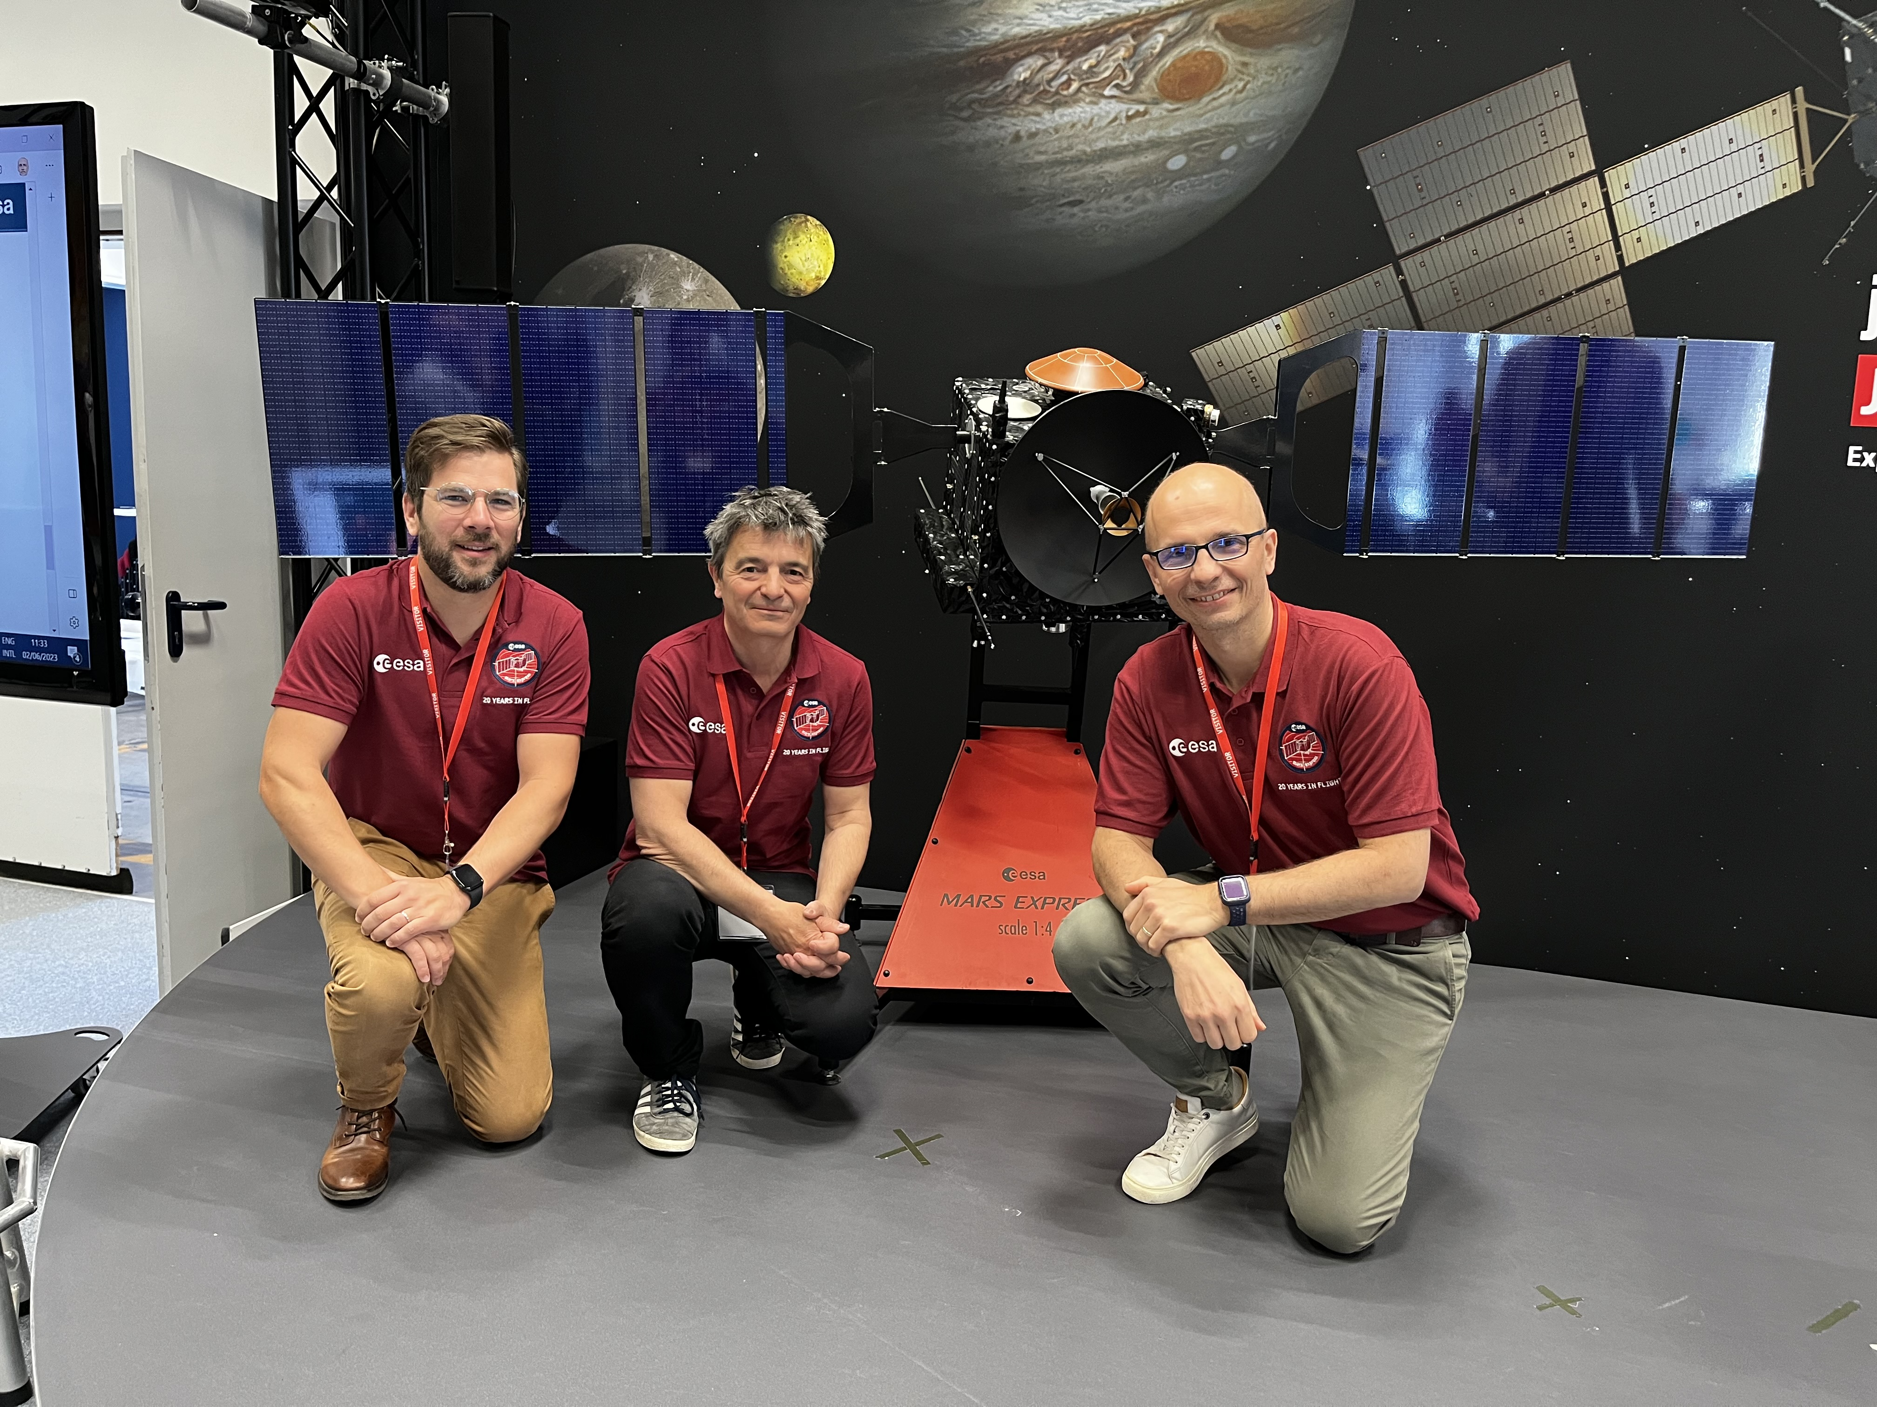
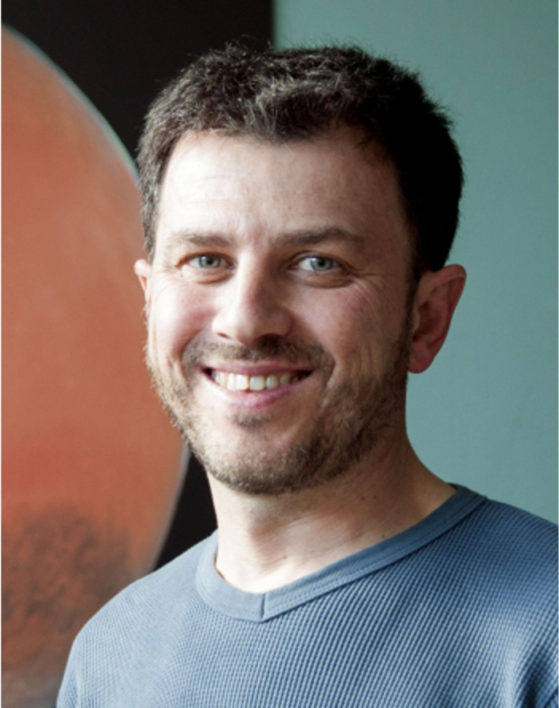












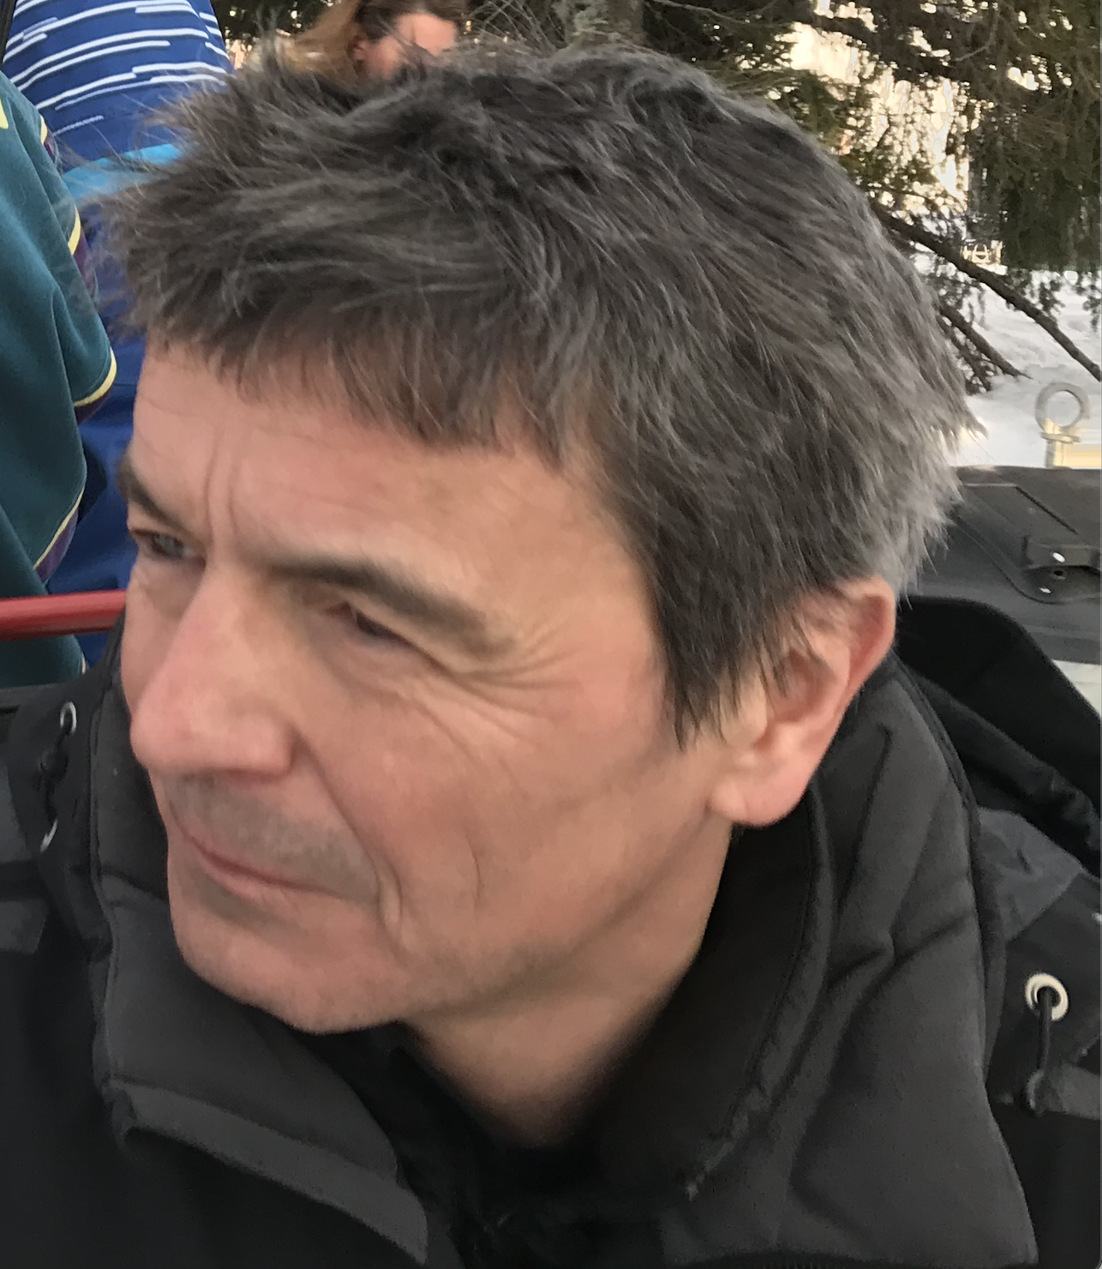









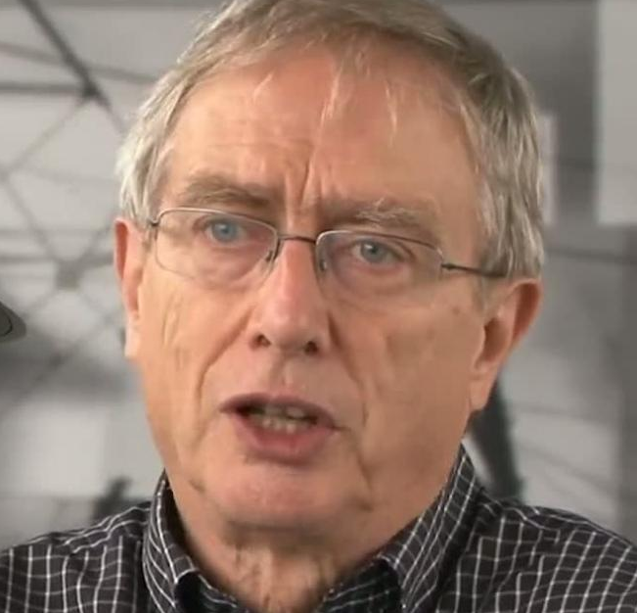
E. Knutsen
T. Fouchet
A. Braude
G. Deprez
A. Stcherbinine
S. Maurice
R. Yelle
S.R. Rafkin
K. Olsen
L. Rossi
J.L. Bertaux
O. Korablev
A. Pottier
A. Piccialli
A. Spiga
J.P. Bibring.
R.M. Haberle
L. Baggio
B. Gondet
F. Forget
D. Belyaev
T. Encrenaz
A. Reberac
A. Fedorova
N.M. Schneider
J. Alday
L. verdier
G. Lacombe
A. Määttänen
M.S. Chaffin
S. Lebonnois
F. Lefèvre
L. Maltagliati
K. Perot
D. Evdokimova
J..T. Clarke
J. Irbah
M. Vals
M. Mayyasi
E. Marcq
P. Rannou
M. Cabane
Notes:
1- esteemed colleagues that received this medal (two of them here)
2- dedicated to the people that at a moment in my carreer , as mentor, colleague, student post do played a pivotal role

Slide 3

A. Piccialli
E. Knutsen
T. Fouchet
A. Braude
G. Deprez
A. Stcherbinine
S. Maurice
R. Yelle
S.R. Rafkin
K. Olsen
L. Rossi
J.P. Bibring.
O. Korablev
A. Pottier
R.M. Haberle
A. Spiga
To Martin…
L. Baggio
B. Gondet
F. Forget
D. Belyaev
A. Reberac
A. Fedorova
N.M. Schneider
J. Alday
K. Perot
A. Määttänen
M.S. Chaffin
G. Lacombe
S. Lebonnois
T. Encrenaz
L. Maltagliati
M. Mayyasi
D. Evdokimova
J..T. Clarke
J. Irbah
M. Vals
E. Marcq
P. Rannou
M. Cabane

Slide 4
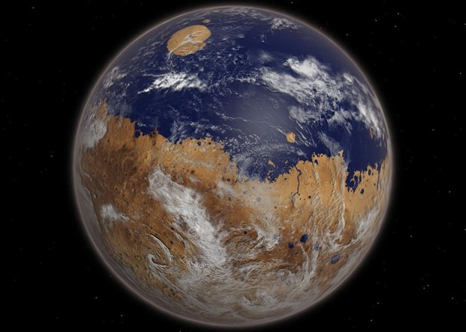
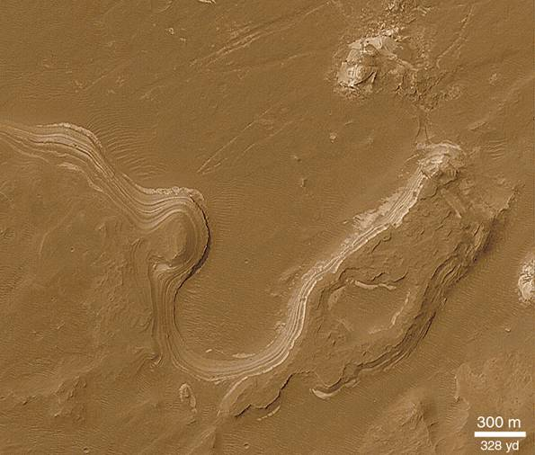
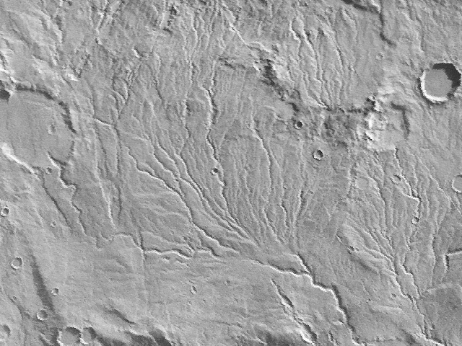
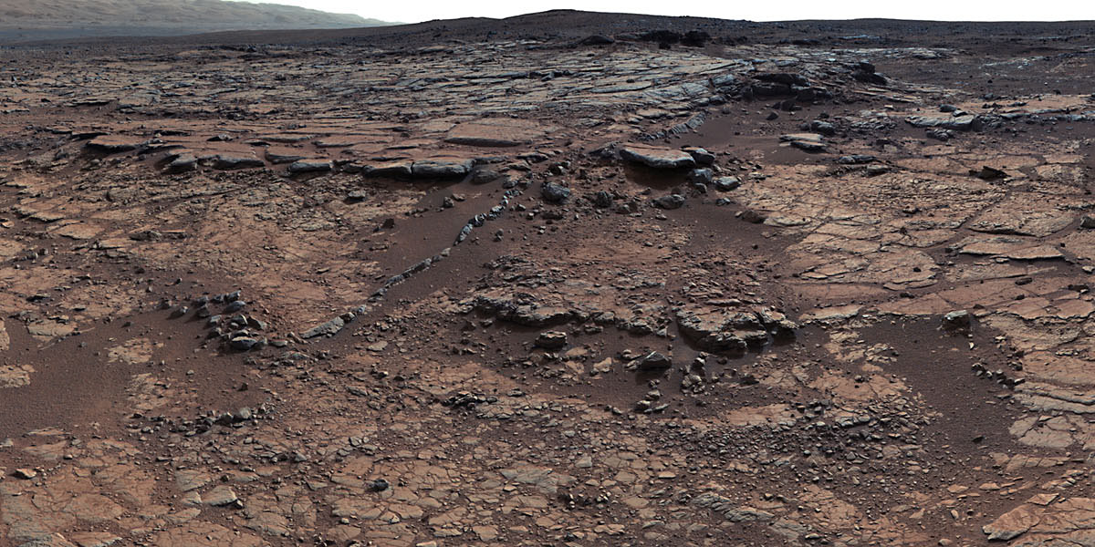
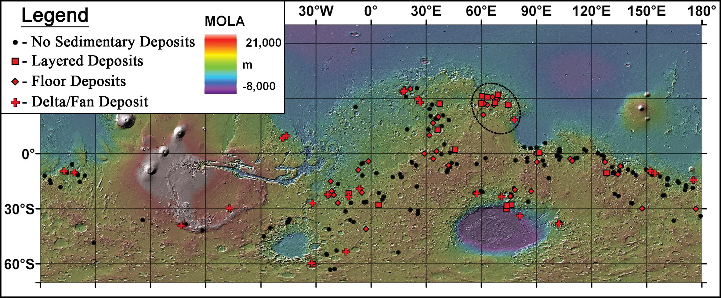
This Mars I won’t talk about.
4 Gyr ago?
>1 bar CO₂
T ≥ 0°C
Notes:
Sorry for those who might have expected me to talk about this ancient Mars that, evidences tell it, might have been a home to life with numerous places where liquid water a mark.
This Mars, I won’t talk about, but let’s keep it in mind for a sec.

Slide 5
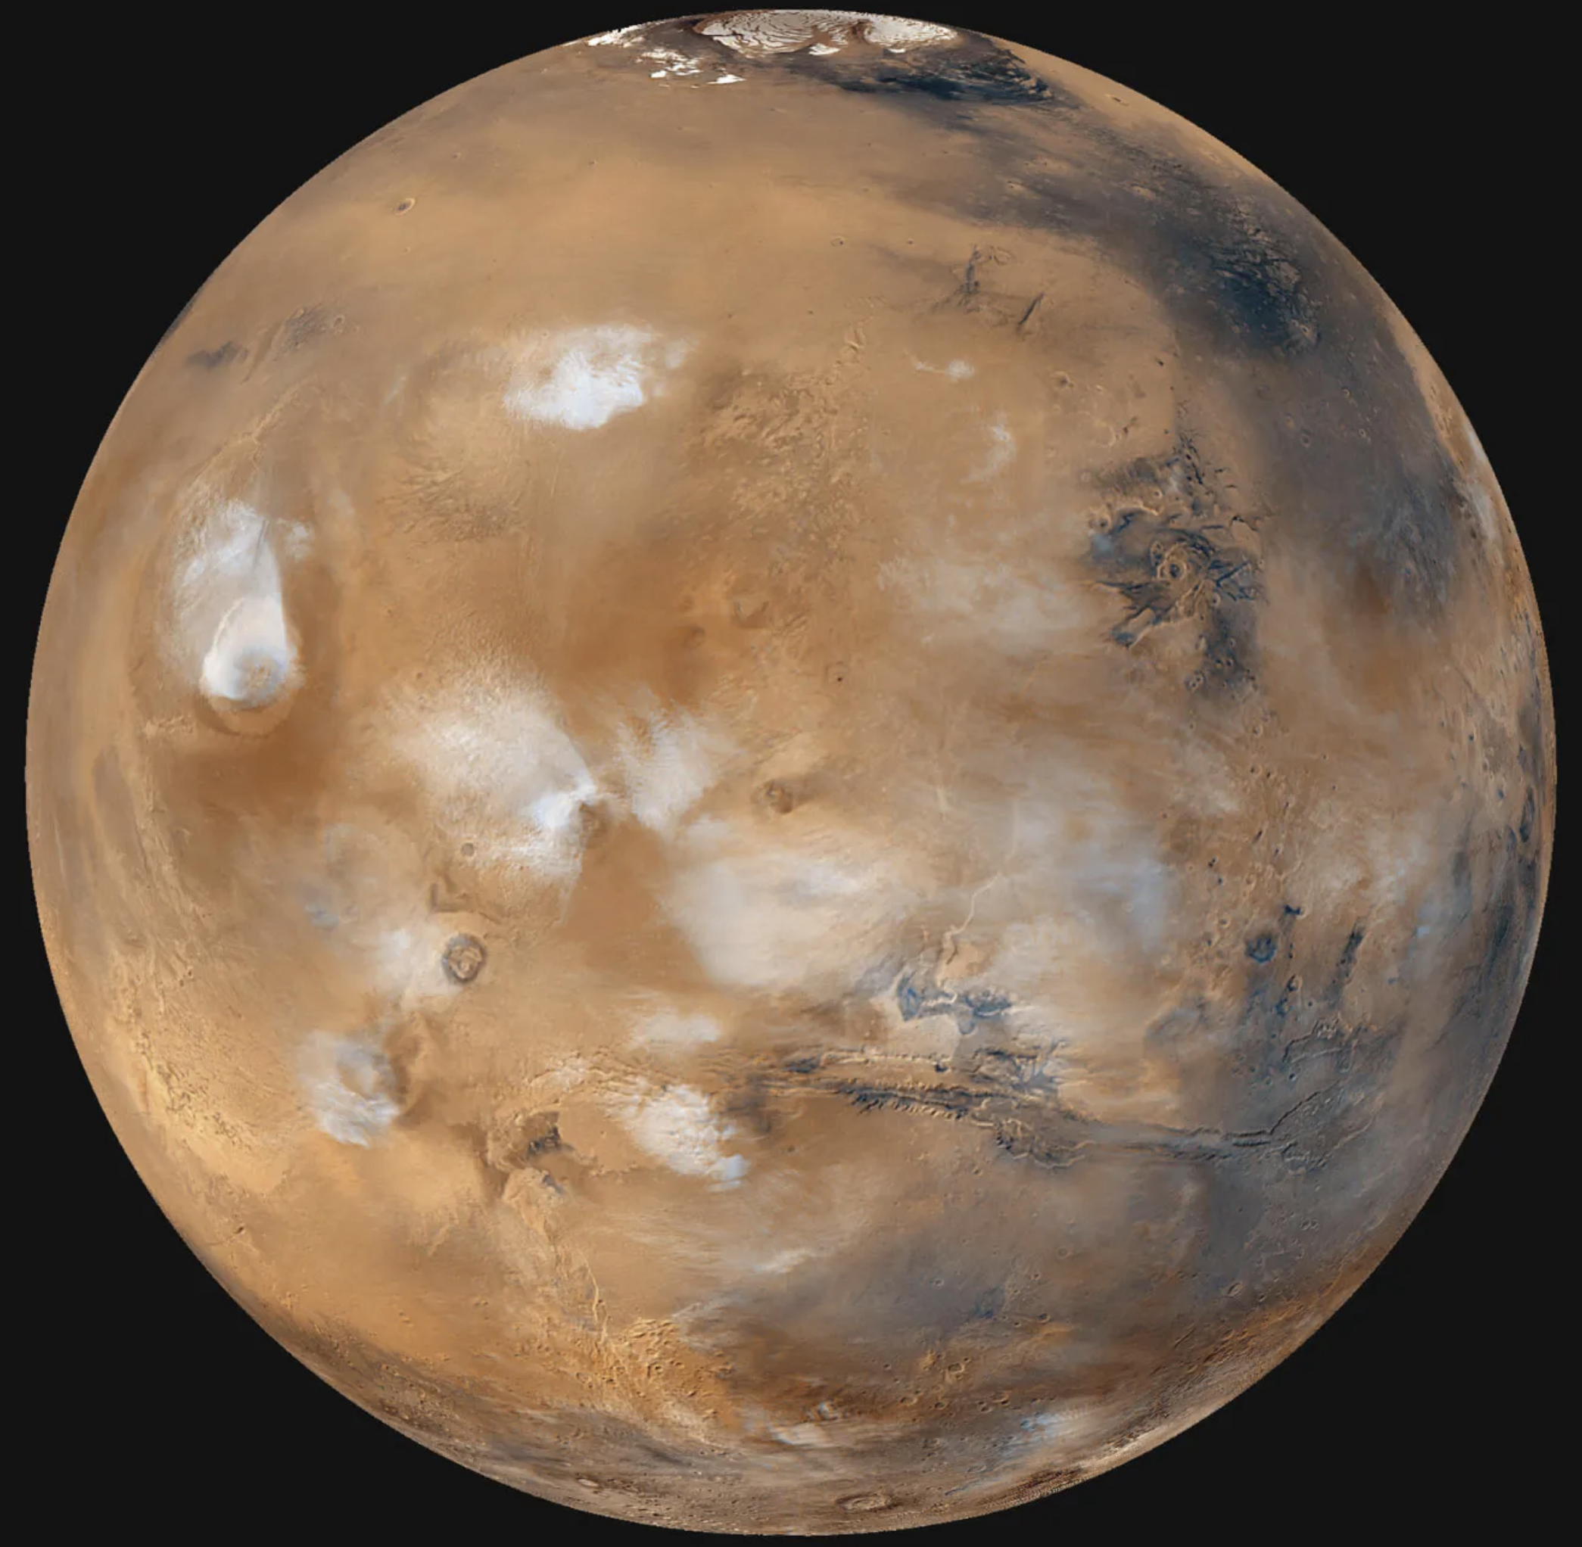
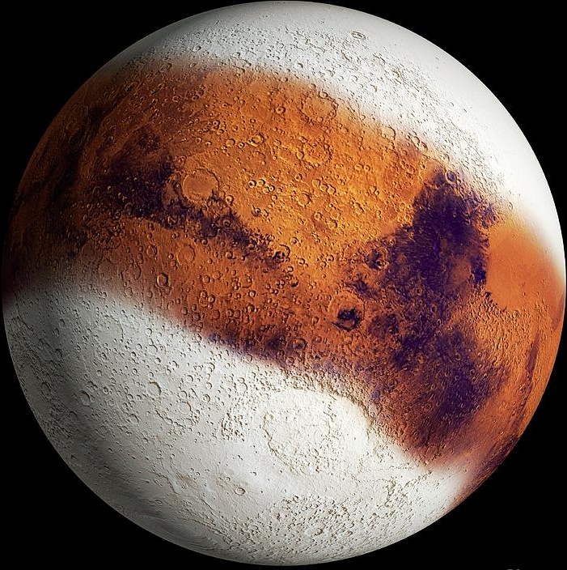
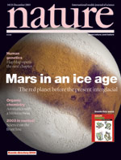
These are my Mars(s).
6 mbar CO₂
T ~ -50°C
Today
5 Myr ago?
Head et al., 2005

Slide 6
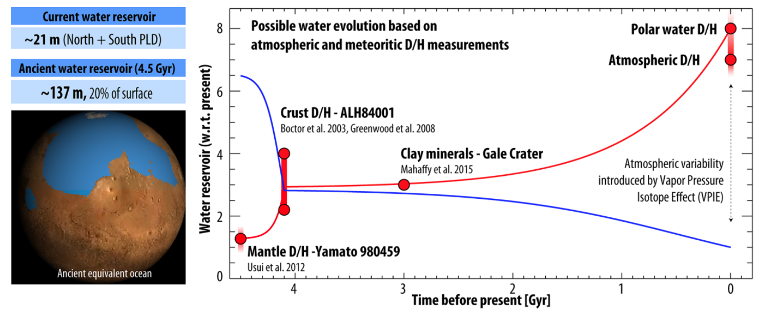
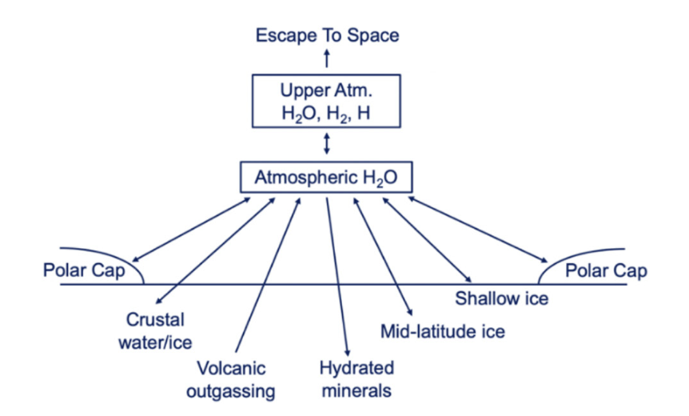
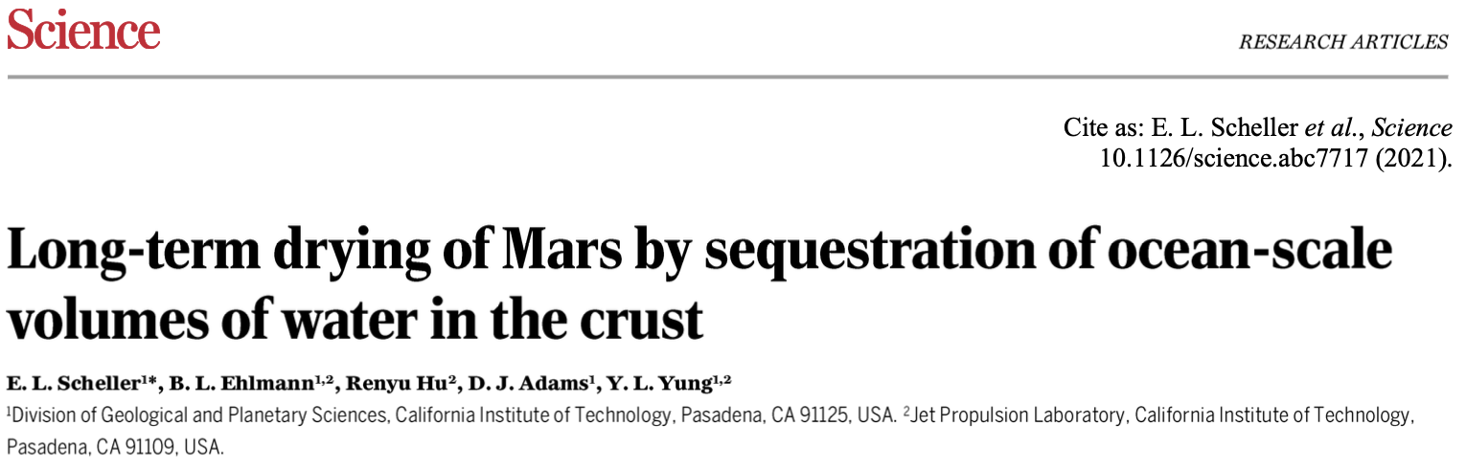
How did we go from to ?
Warm
Wet
Cold
Dry
Villanueva et al. (Science, 2015)
Jakosky and et al. (JGR-p, 2024)
“Summed up, they total 380–970 m H₂O (as a global equivalent layer), and possibly up to 685–1,970 m if possible crustal liquid water or ice is included.”
Scheller et al. (Science, 2021)
Scheller et al. (Science, 2021)
Notes:
However, one key that remains is how did we got from that warm and wet Mars to this cold and dry planet that we know today.
This has been the topic of numerous studies.
One clue comes from the enrichment of atmospheric water in deuterium that suggests Mars lost its hdrogen, at least 6 times more as it is 6 times more enriched than Earth ocean
We also know water has been trapped intominerals.
Recent inventory suggests there might have been the equivalent of a 1-km thick ocean 4 Gyrago

Slide 7
How did we go from to ?
Warm
Wet
Cold
Dry
Villanueva et al. (Science, 2015)
Jakosky and et al. (JGR-p, 2024)
“Summed up, they total 380–970 m H₂O (as a global equivalent layer), and possibly up to 685–1,970 m if possible crustal liquid water or ice is included.”
Present-day water cycle
Scheller et al. (Science, 2021)
Scheller et al. (Science, 2021)
Notes:
It is clear though that atmosphere is a bottleneck reservoir that communicates with every other reservoir and thus has played a key role in the evolution of water.
And that some of the processes that led to Mars being dry are still operating today and can be gauged through the present-day water cycle

Slide 8
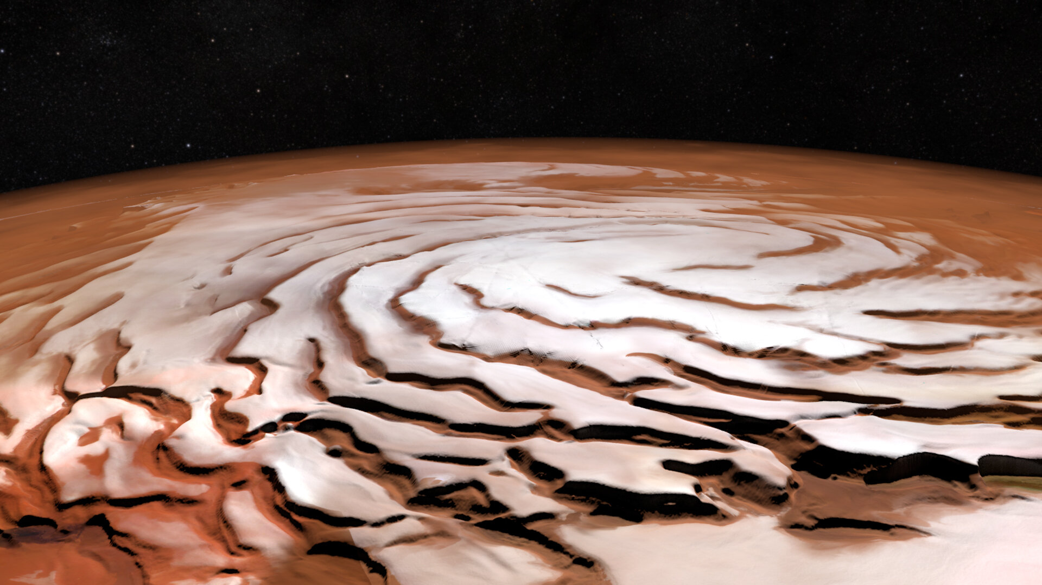
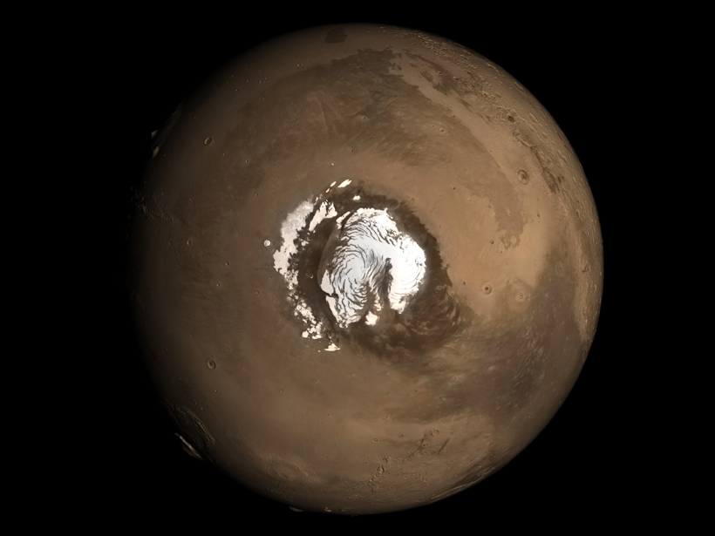
The massive glacier (3000 km³ of ice) of the permanent Northern polar cap is the “driving force” of the present-day Mars water cycle.

Slide 9
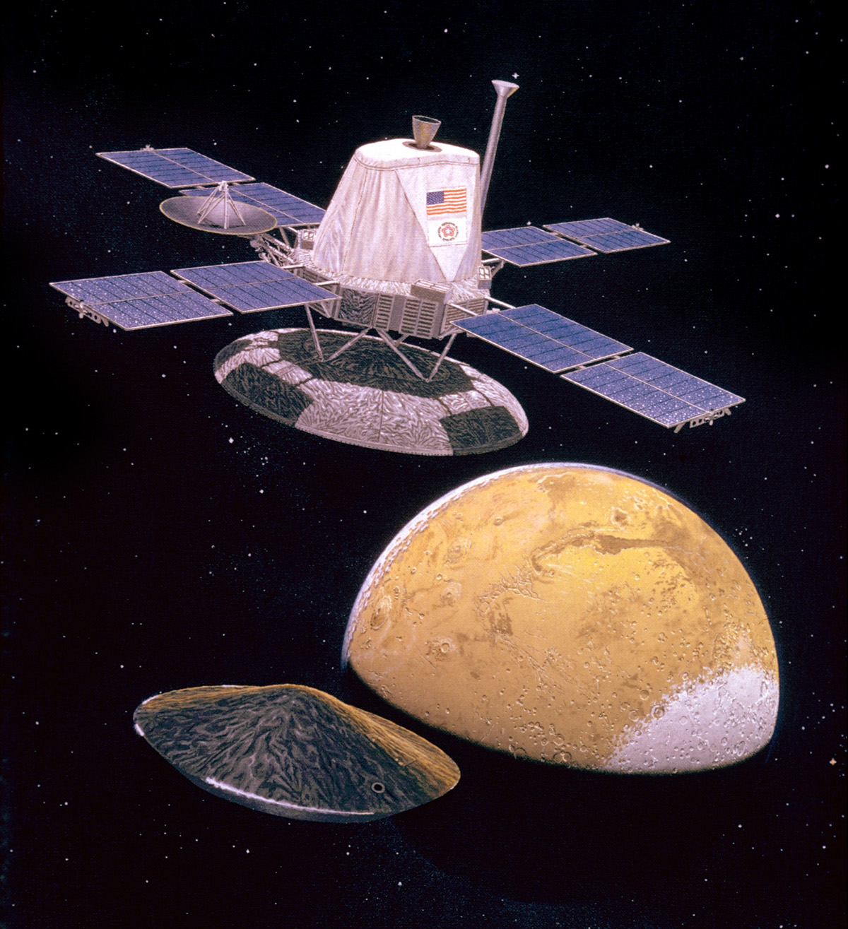
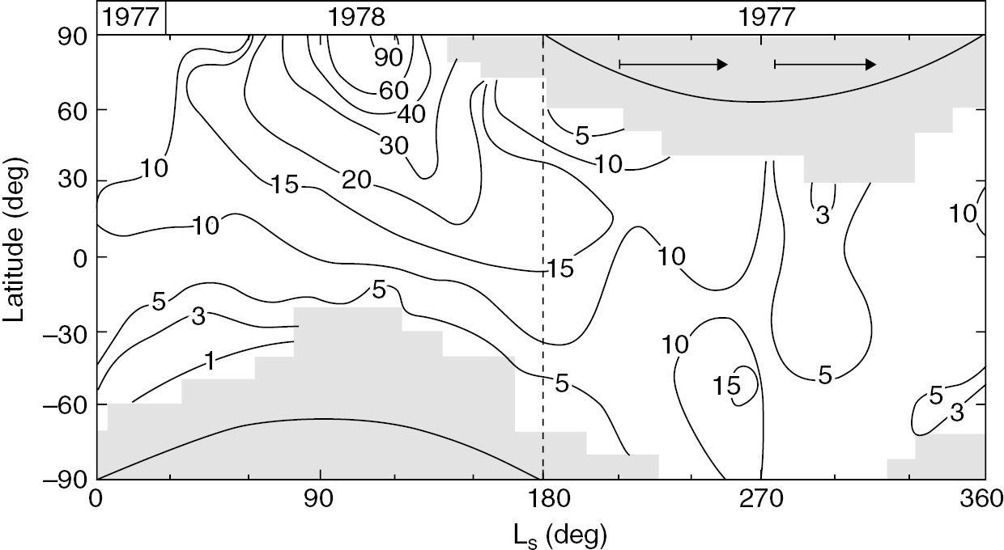
Mars’ water cycle: Genesis of a story
Spring
Summer
Fall
Winter
The first climatology of H₂O by the MAWD instruments onboard the two Viking orbiters
(Jakosky and Farmer, 1982)
NASA Viking missions 1&2
(1975-1980)
Notes:
When it comes to the WC, it’s fair to say evertyhing started with the MAWD NIR spectrometer that tracked the CA of H2O over more than a Martian year
Say that we measure the evol of a Amrtian year with the Solar Longitude metric

Slide 10
Mars’ water cycle: Genesis of a story
H₂O vapor column abundance is expressed in
precipitable-micrometer
1 pr-μm
= 1 g/m²
(0.01% = 100 ppmv global mean)
On Earth (pr-mm)
= 1 kg/m²
(0.25% global mean)
Spring
Summer
Fall
Winter
The first climatology of H₂O by the MAWD instruments onboard the two Viking orbiters
(Jakosky and Farmer, 1982)
Notes:
We see two omportant features:
a peak of water in the north
and extremely dry and cold polar nights where H2O vapor is almost inexistent
On average the CA is 10 pr um tbc with the mm or so liquid equivalnt in Earth atm

Slide 11
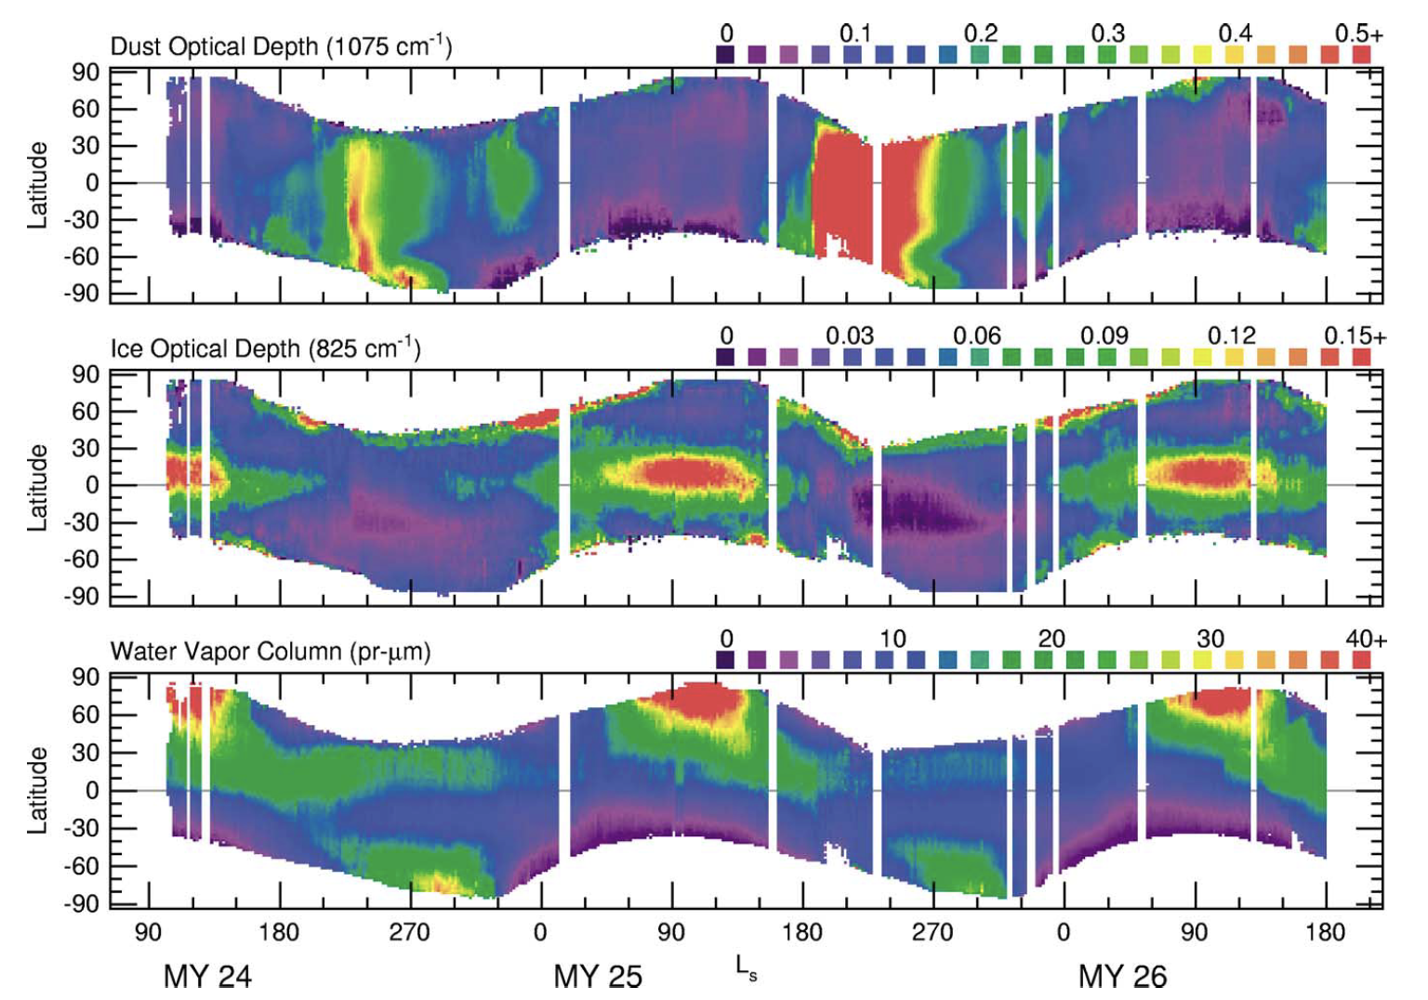
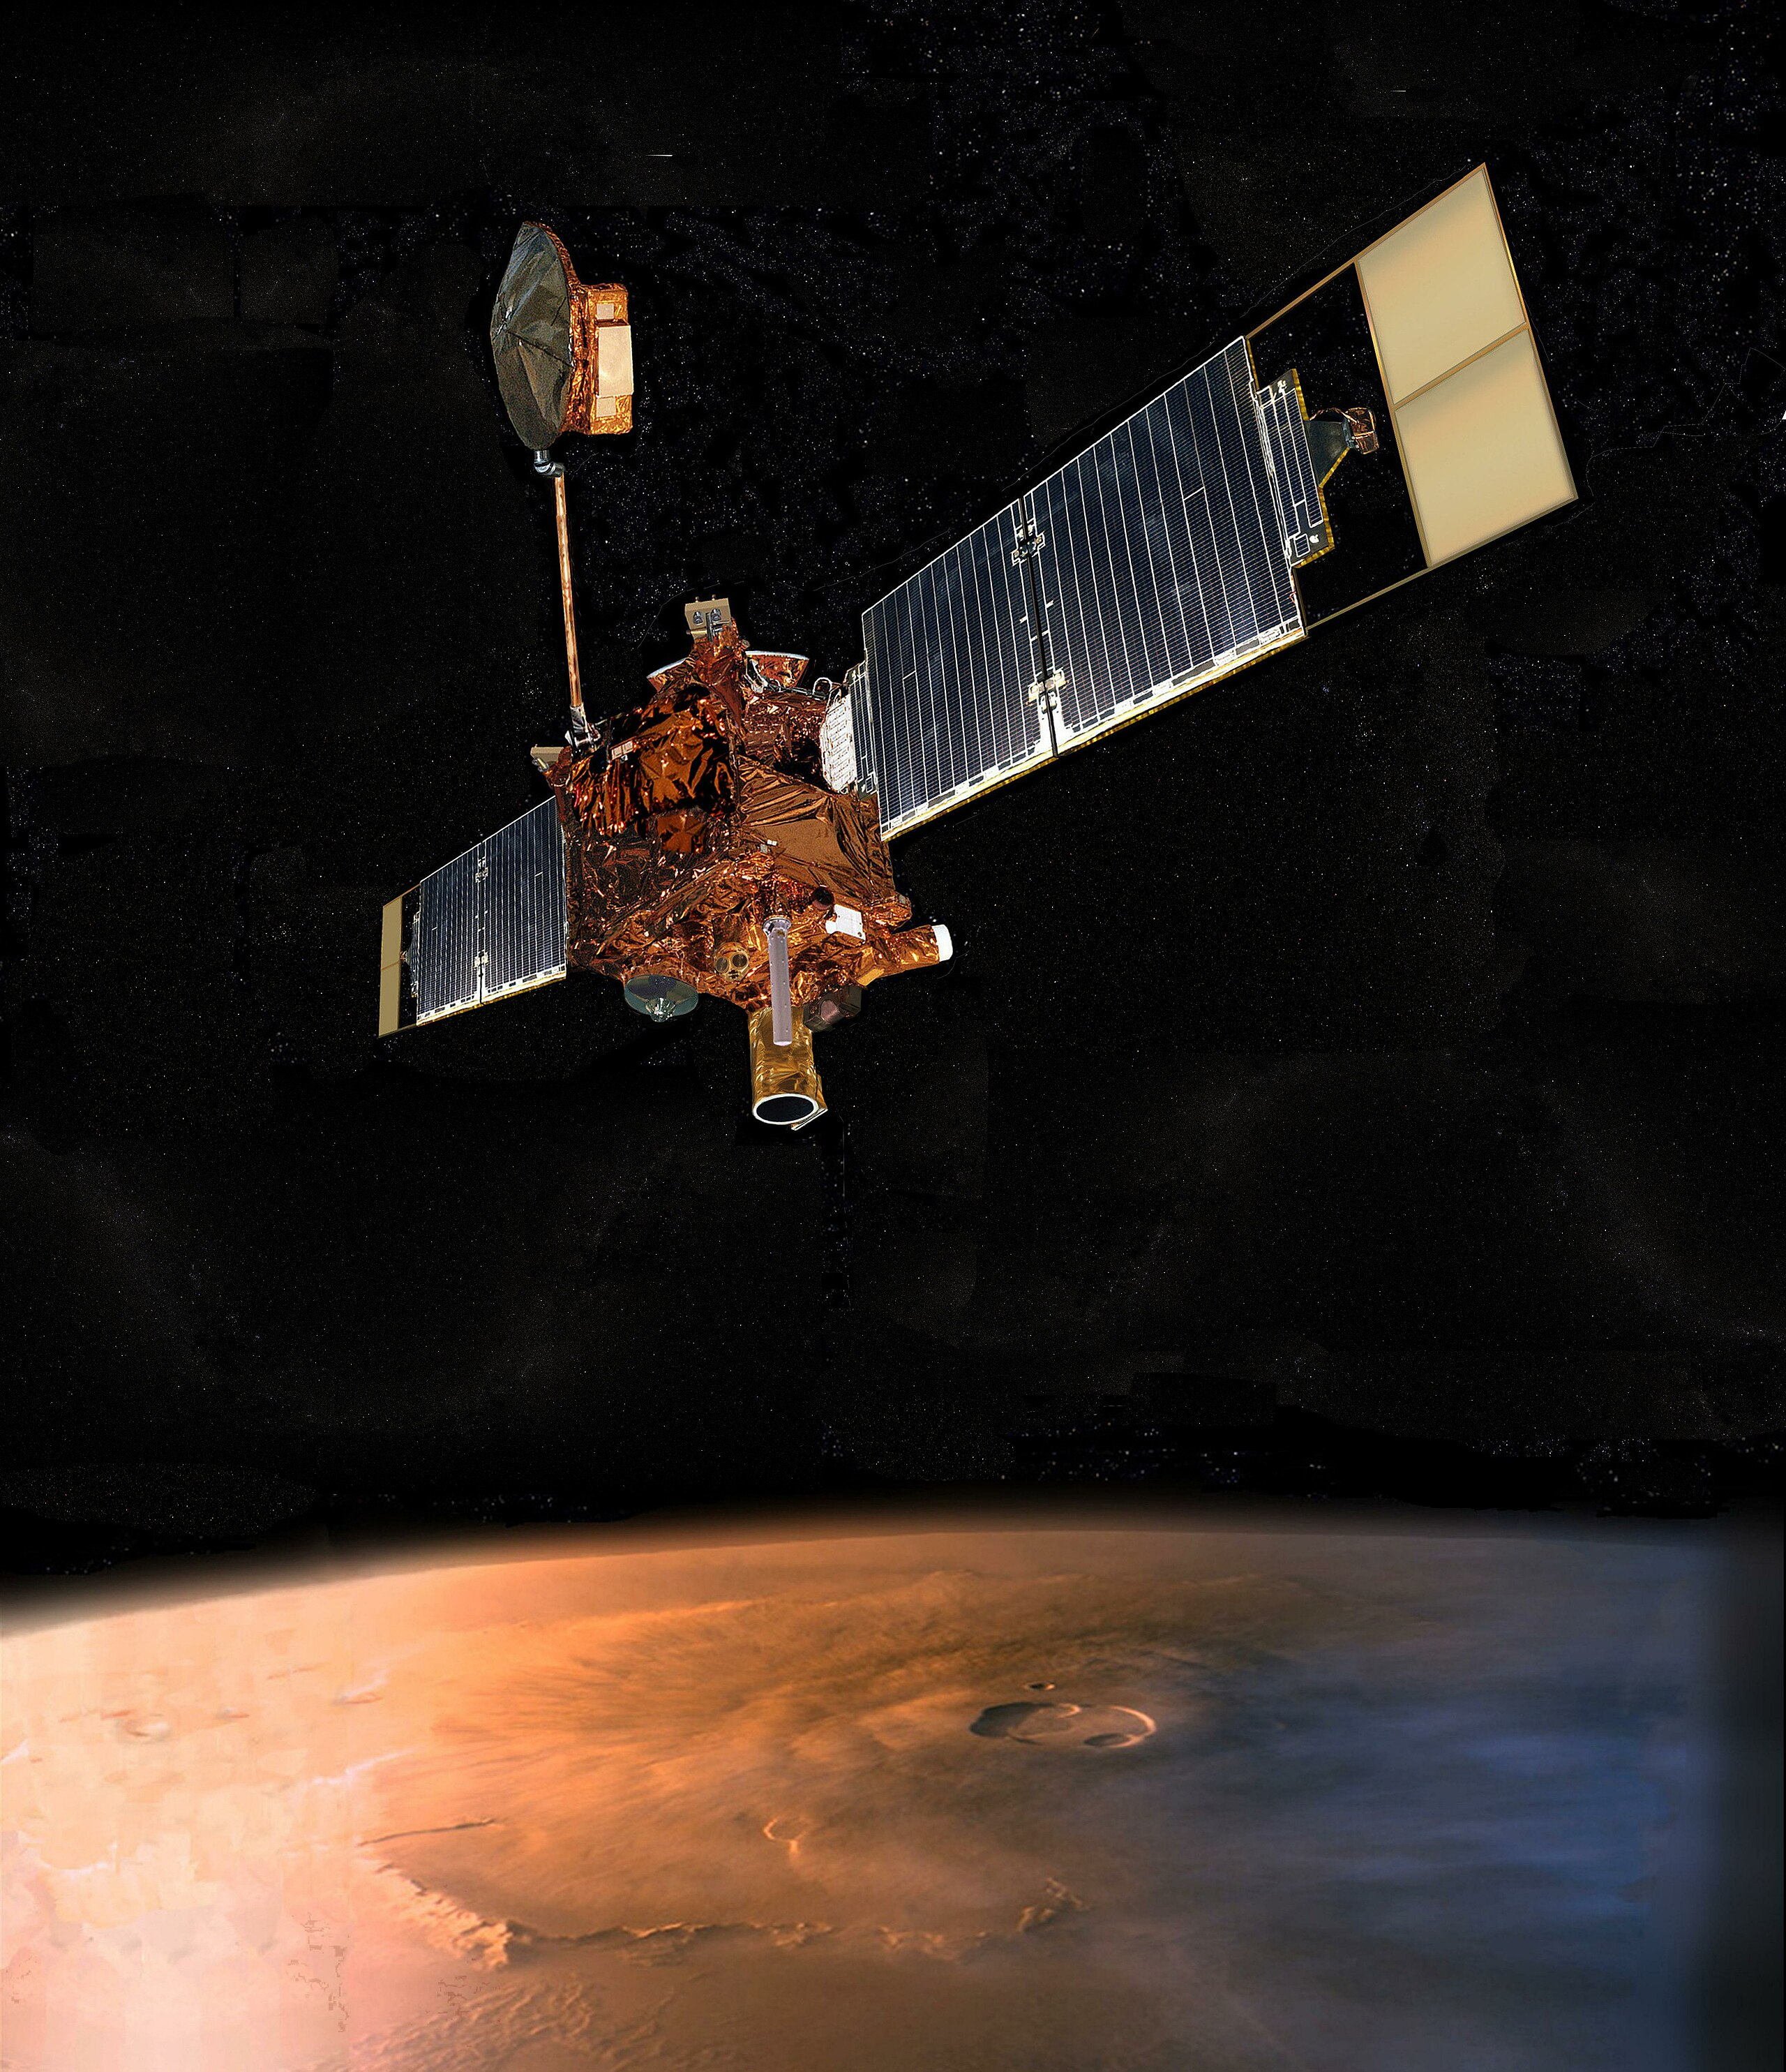
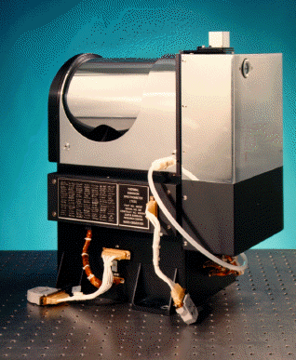
Mars’ water cycle: the TES era…
H₂O vapor
H₂O
ice
(clouds)
Aphelion cloud belt
Aphelion cloud belt
NASA Mars Global Surveyor
(19996-2006)
Smith, 2004 – Mars Global Surveyor
Observations by the Thermal Emission Spectrometer (TES)
Notes:
The same fetaures as MAWD and above all the same features year after year
This time with the monitoring of H2O ice clouds and the strong presence of the Aphelion CB correlating with Mars being the farthest from the Sun and with a maxium of H2O at the pole

Slide 12
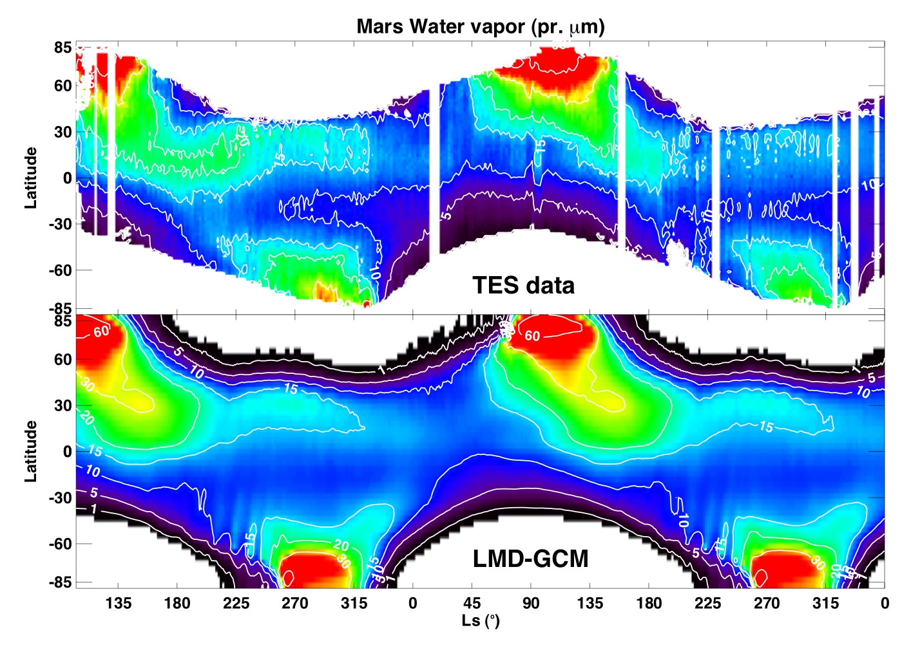
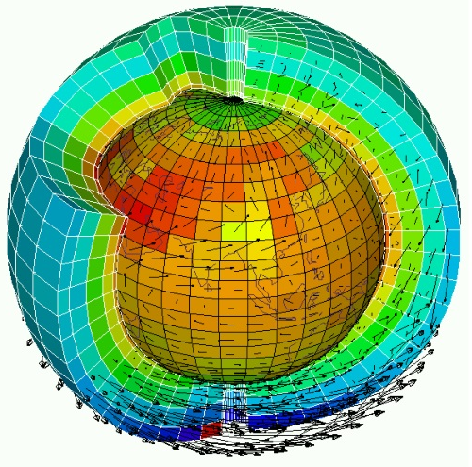
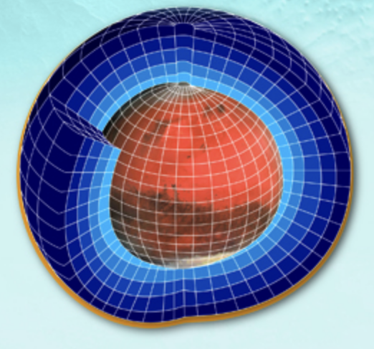
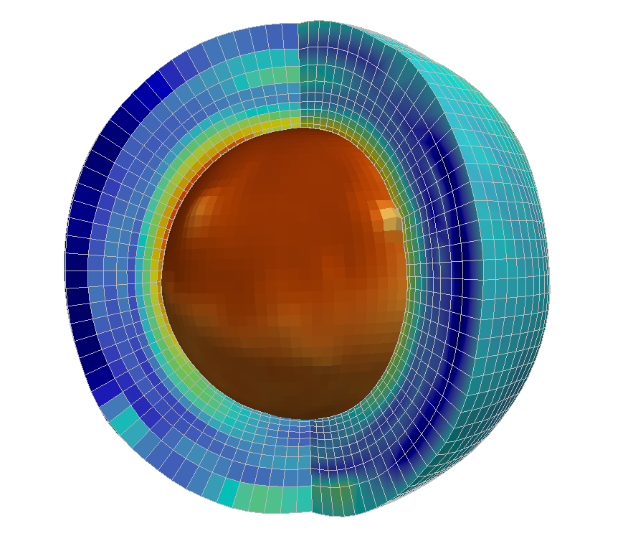
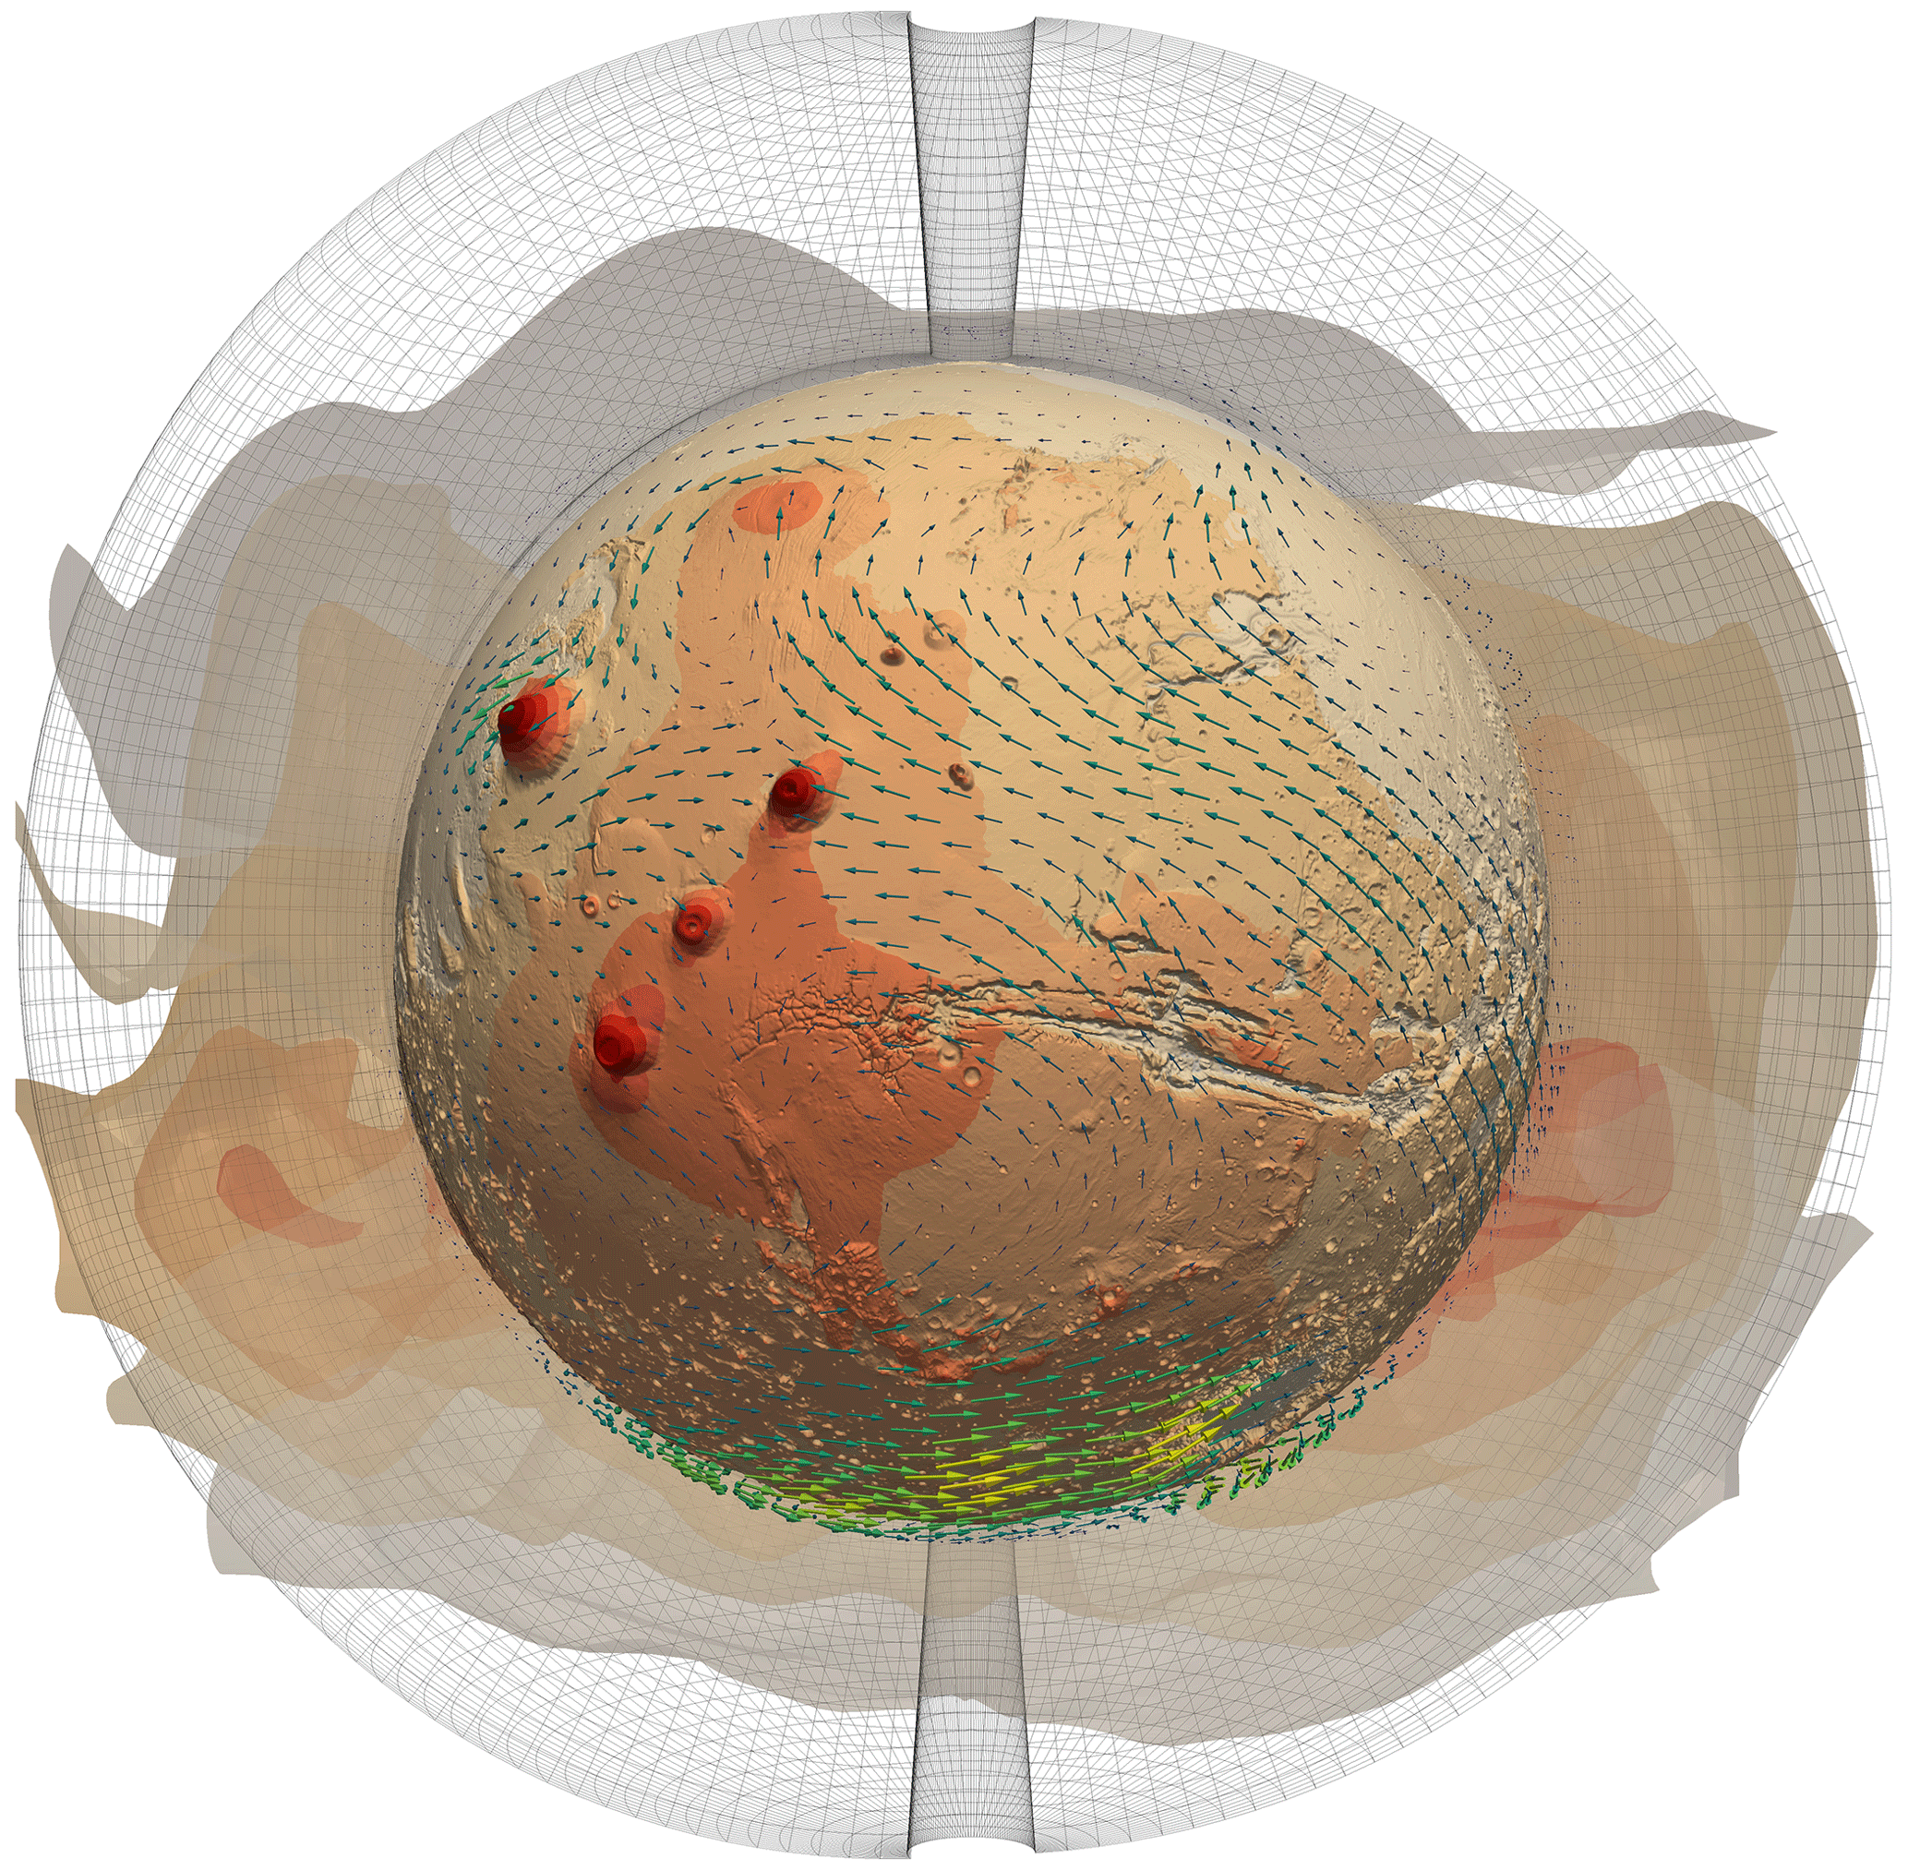
Mars’ water cycle: the 3D Mars climate model era…
Mars Planetary Climate model
(Fr, Sp, UK)
Ames Mars Global Climate model
(US)
Global Environmental Multiscale model for Mars
(Bel, Ca)
Met Office Unified Model (UK)
Montmessin, Forget et al. (JGR, 2004)
+ others
Notes:
At the same time, 3D GCM started to gain sufficient maturity to reproduce most of the observed features of the WC
+ many other models since them

Slide 13
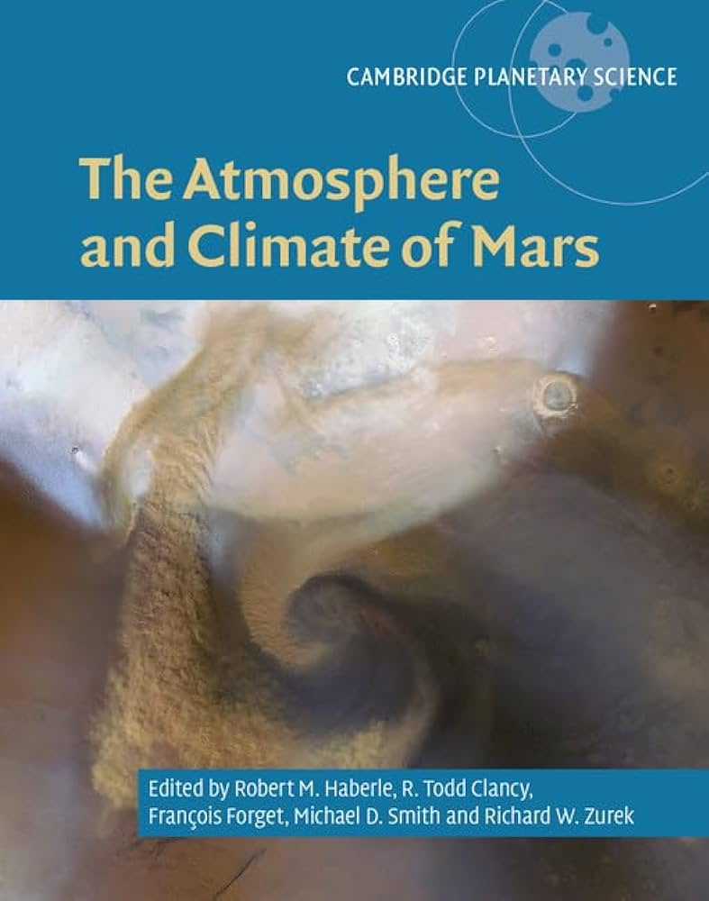
Mars’ water cycle in 3 acts
(Montmessin et al., “The Water Cycle”, Mars Atmosphere and Climate Book, 2017)
1. Summertime “exfiltration”
Smith (2002)
3. Water returns “home”
1
2
2. Inter-hemispheric Transfer
3
L_{s}
Summer
Fall
Winter
Spring
Summer
Notes:
These models have enabled an in-depth understanding
If we were to decompose the WC in , we would bring forward the following moments

Slide 14
Mars’ water cycle in 3 acts
~1 billion tons of H₂O vapor is released by
the North polar cap every year.
1. Summertime “exfiltration”
Smith (JGR, 2002)
1
Summer
Fall
Winter
Spring
Summer
Notes:
1.NPC sublimation that releases 1 billion ton … that subsequently spreads towards the rest of the plant

Slide 15
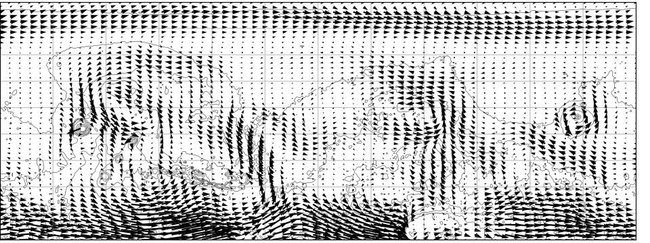
1st act: Summertime extraction of H₂O from the north polar cap
Three « wet » corridors (Arcadia, Acidalia and Utopia) allow water to leave the north polar cap.
Water vapor column (pr-μm) in Northern summer
60
Arcadia
Acidalia
Utopia
Arcadia
Acidalia
Utopia
40
20
10
0
The way the sublimation peak of water vapor is “flushed” from the north polar cap can be explained by a particular pattern of transport.
Notes:
Things are not that simple, and for almost twenty years, no one could reproduce the way was leaving the polar cap to humify the equator
We see here that the spread actually occurs through three main corridors

Slide 16
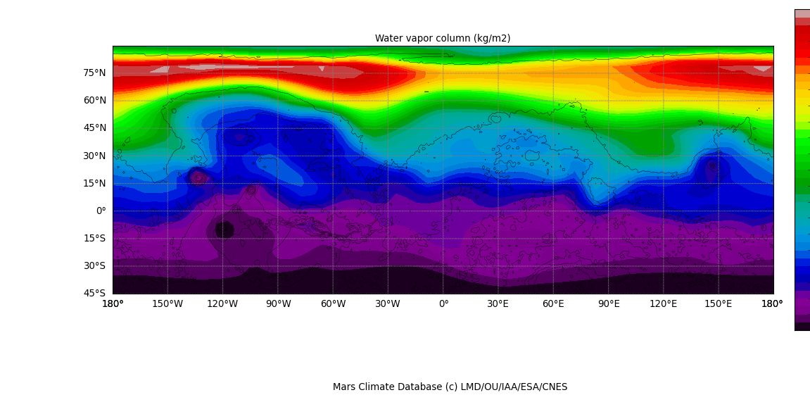
1st act: the model explanation
Water vapor column (pr-μm) in Northern summer
60
Arcadia
Acidalia
Utopia
40
20
10
0
Cause: surface properties change between Arcadia, Acidalia and Utopia planitiae
Consequence: main mechanism carrying water from the north pole to low latitudes.
The way the sublimation peak of water vapor is “flushed” from the north polar cap can be explained by a particular pattern of transport.
Notes:
These corridors correspond with dynamical features that consist in three cyclonic storms permanently located in the three regions
This dynamical configuration is imparted by topography and surface properties which allows water to be exported from the pole to the equator

Slide 17
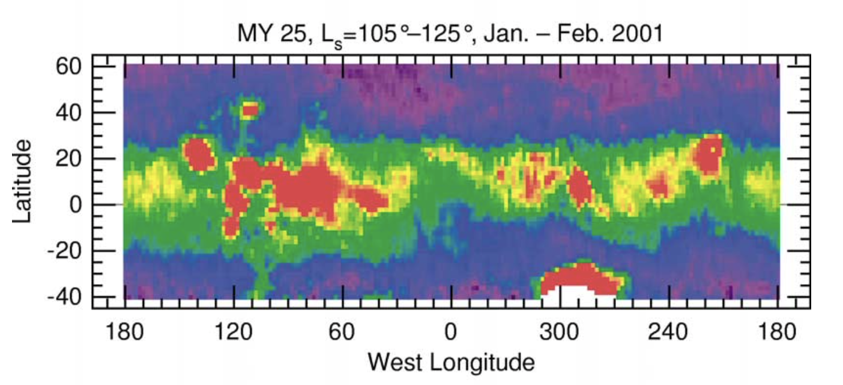
Mars’ water cycle in 3 acts
Smith (2002)
1
2
2. Inter-hemispheric Transfer
L_{s}
Summer
Fall
Winter
Spring
Summer
Aphelion cloud belt
Notes:
The second ac t concerns the trasfer from one hemisphgere to the other, we esee here that it coincides with the formation of clouds

Slide 18
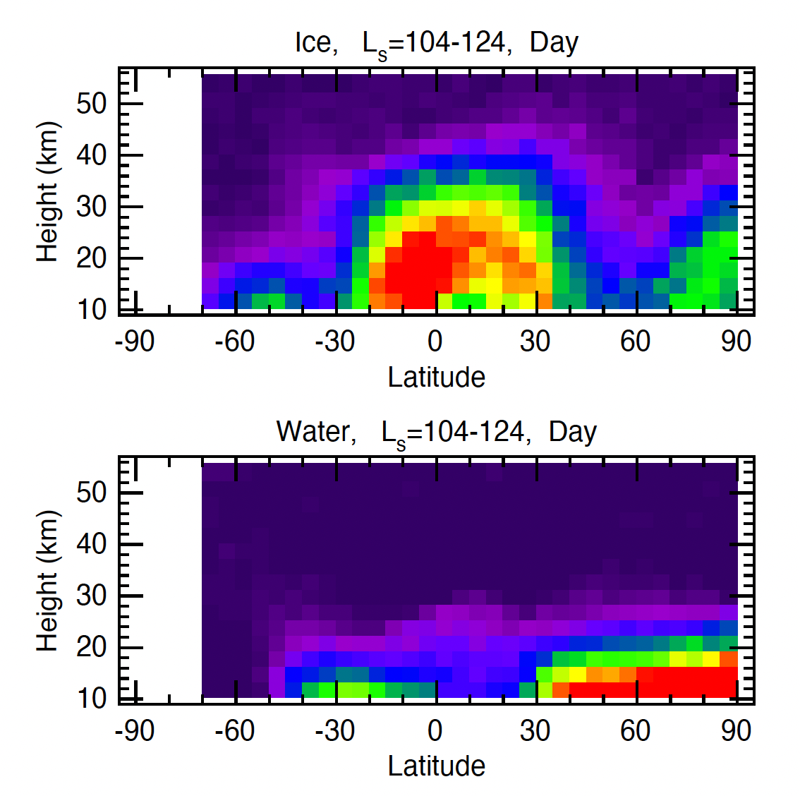
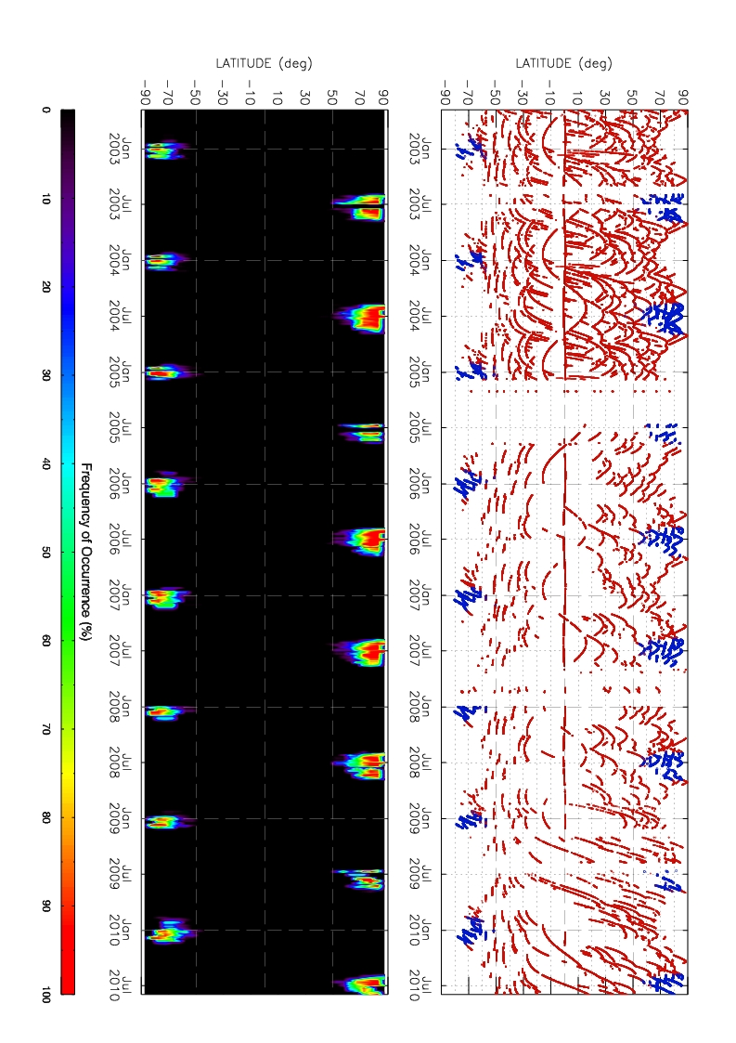
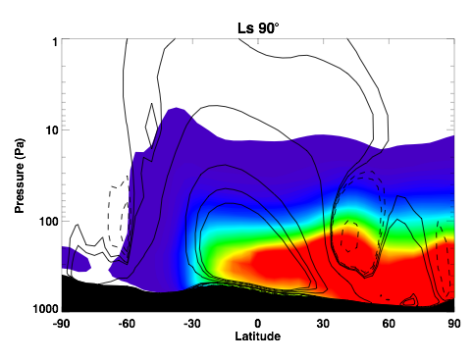
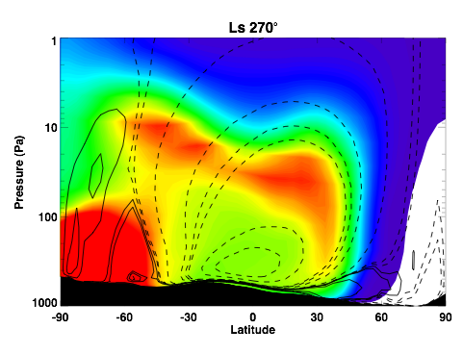
2nd act: Inter-hemisphere transfer: the Clancy effect
200
Northern summer
(colder and cloudier)
Southern summer
(warmer and dustier)
60
60
40
TES (Smith)
50
Altitude (km)
H₂O mixing ratio (ppmv)
Aphelion cloud belt
20
0.1
The Aphelion Cloud belt causes water retention in the Northern hemisphere and is partly responsible for the North-to-South H₂O asymmetry
Montmessin (JGR, 2004)
Notes:
Key seasons for inter-hemispheric exchanges = northern and southern summer solstices
Presence of a single circulation cell that transports air masses.
Superposition of water vapor contours and current functions.
Cold atmosphere at aphelion = low condensation level = clouds and precipitation
Striking contrast between the two seasons, which partly explains why the Northern Hemisphere is always wetter than the Southern Hemisphere.

Slide 19
Mars’ water cycle in 3 acts
Smith (2002)
3. Water returns “home”
1
2
3
L_{s}
90°
180°
270°
0°
90°
L_{s}
Summer
Fall
Winter
Spring
Summer
Notes:
The third act is the once that brng water back home

Slide 20
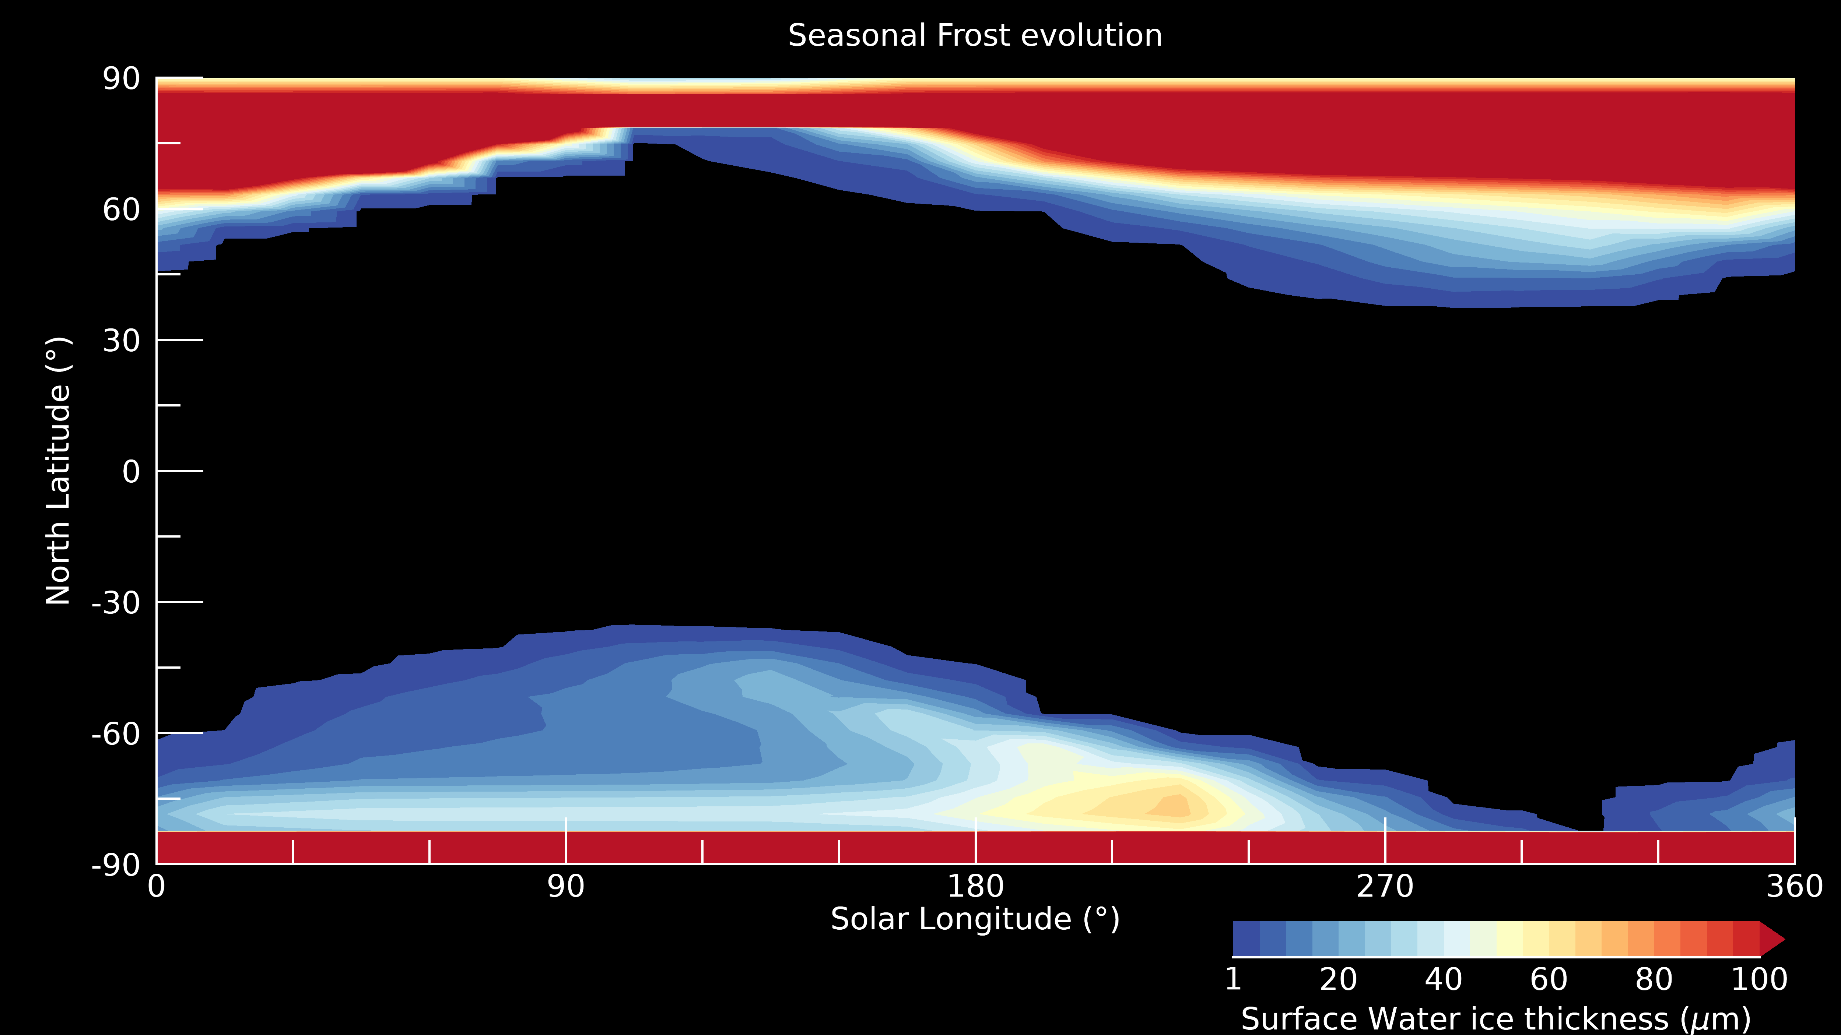
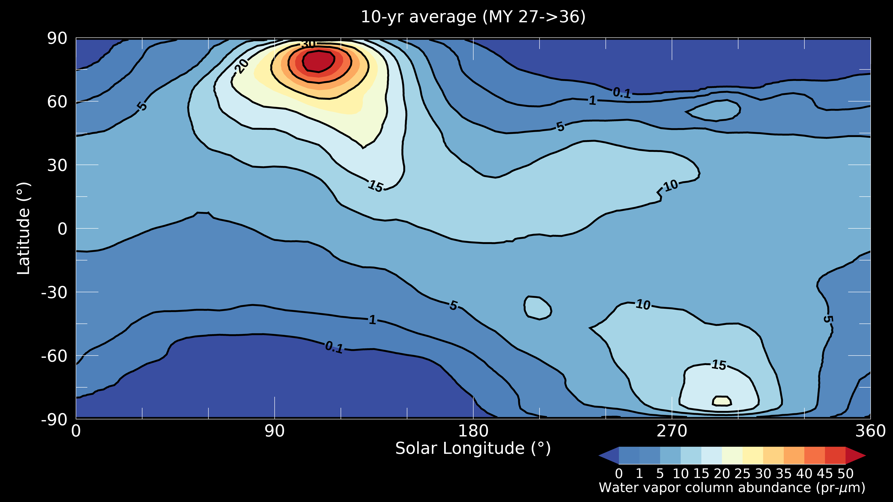
3. Water returns “home”: The Houben’s mechanism (Houben et al., 1997)
Mars Climate database:
simulated H₂O frost
Mars Express SPICAM:
10 yr-average H₂O vapor
Notes:
Here we consider the role of the exchanges between the water in the atm and the water at the surf
We have understood with the work of Hoube; et al that frost that forms in the polar night is going back to the pole during the end winter, early spring, finally releasing to the pole

Slide 21
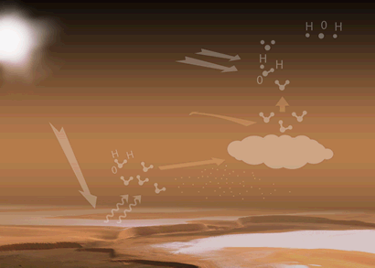
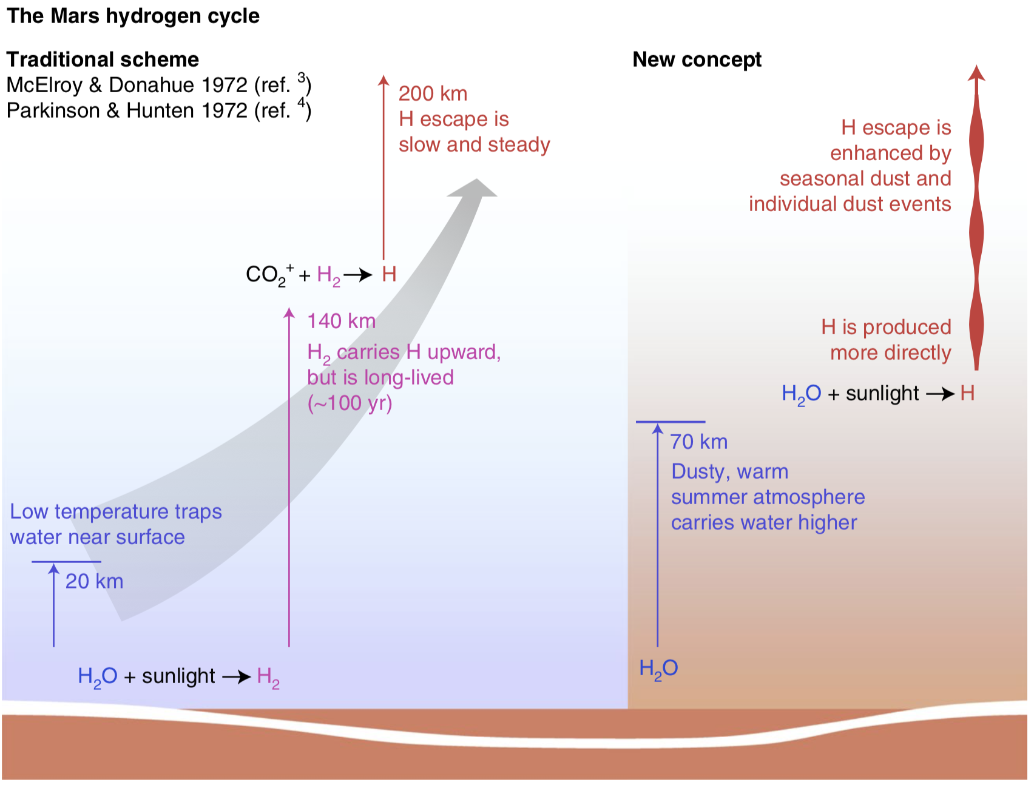
From surface to space…”altitude”, the missing dimension
H₂O decomposition
Transport
Cloud formation
Surface ice Sublimation
Credit: ESA
Chaffin et al. (Nature Geos, 2017)

Slide 22
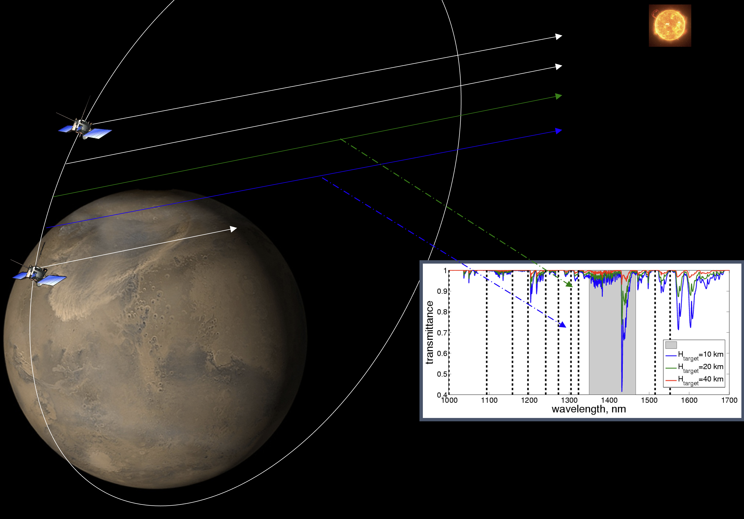
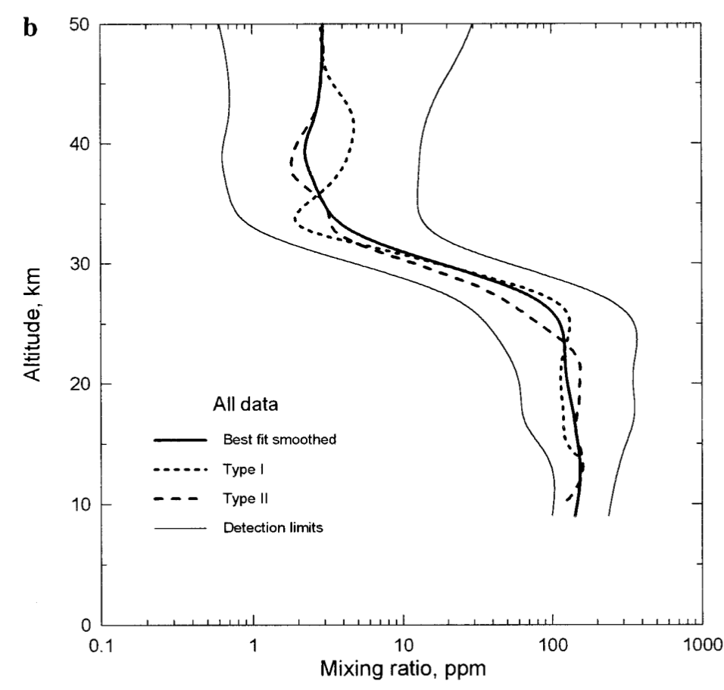
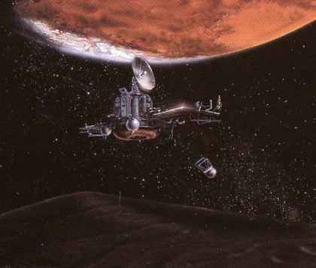
Probing H₂O vs. altitude…First attempts
Uniformly mixed
Solar occultation
Hygropause (condensation)
Uniformly mixed
Phobos 2 mission Solar occultation profiles.
Rodin et al. (Icarus, 1997)
Roscosmos Phobos 2 mission (1988-1989)

Slide 23
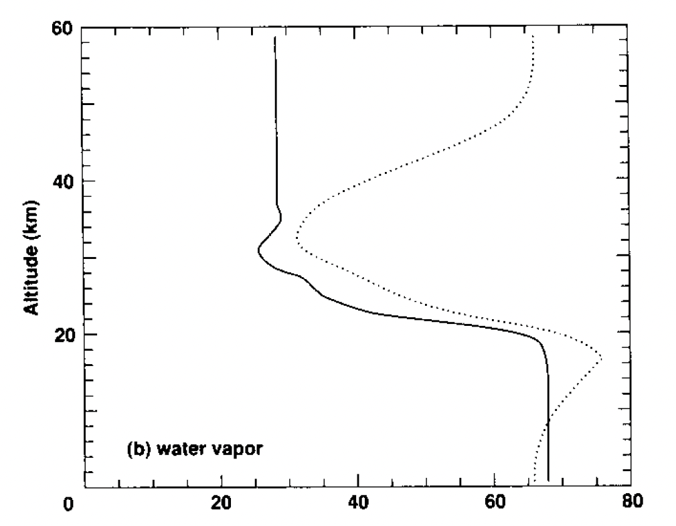
Probing H₂O vs. altitude…First attempts
Uniformly mixed
Hygropause (condensation)
Uniformly mixed
Phobos 2 mission Solar occultation profiles.
Rodin et al. (Icarus, 1997)
1D-model of cloud microphysics
Michelangeli et al. (Icarus, 1993)

Slide 24
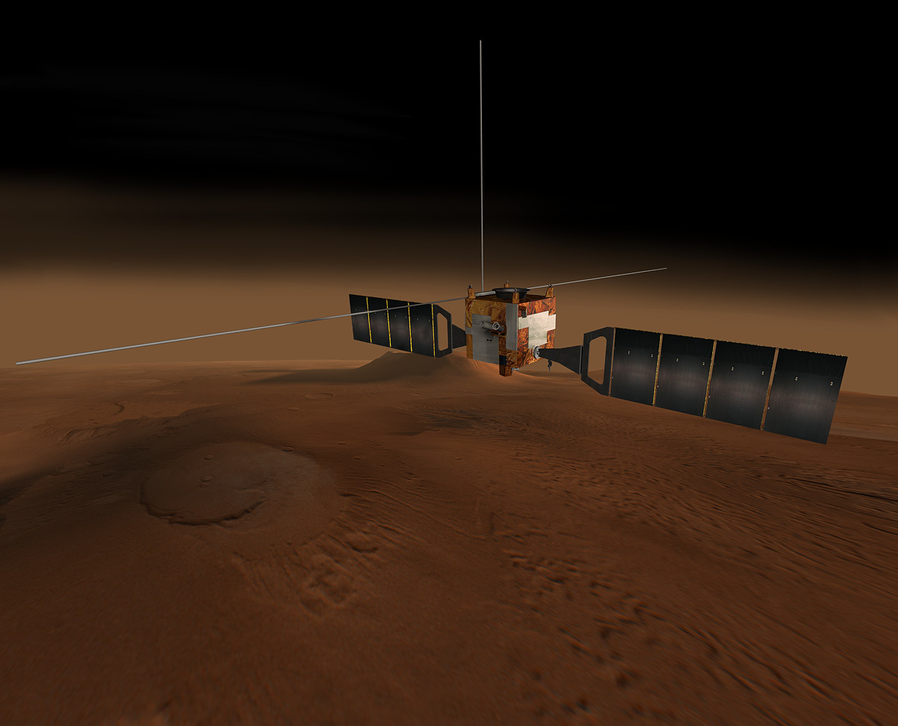

Probing H₂O vs. altitude …the SPICAM survey
ESA Mars Express mission (2003- )
Maltagliati, Montmessin, Fedorova et al. (Science, 2011)

Slide 25



Probing H₂O vs. altitude …supersaturation
Mars PCM predictions at SPICAM 2011 observation locations and local time
Supersaturation caused by (1) slow condensation vs. T change
(2) lack of dust nuclei
Maltagliati, Montmessin, Fedorova et al. (Science, 2011)
Navarro et al. (JGR, 2014)

Slide 26

Probing H₂O vs. altitude…the high water case
Maltagliati, Montmessin, Korablev et al. (Icarus, 2013)

Slide 27
Probing H₂O vs. altitude…the high water case
Southern summer
(warmer and dustier)
60
40
Altitude (km)
20
0.1
50
200
H₂O mixing ratio (ppmv)
Maltagliati, Montmessin, Korablev et al. (Icarus, 2013)

Slide 28


At (almost) the same time…
Hubble Space Telescope image
of Lyman-α brightness (kR)
Mars Express SPICAM
Clarke et al. (GRL, 2014)
Chaffin et al. (GRL, 2014)

Slide 29
The hydrogen paradigm shift
Chaffin et al. (2021)
70’s Paradigm Water escape is regulated by the slow (>years) formation and upward migration of H₂ where ion chemistry turns it into escaping H.
Problem This scheme is not compatible with observed rapid (weeks) changes of Mars’ hydrogen corona.
New Paradigm Southern spring & summer induce massive and rapid water propagation at high altitude (>80 km), leading to direct H production and deposition.
Chaffin et al. (Nature Geos, 2017)

Slide 30


Then TGO enters the game…
ESA Trace Gas Orbiter mission (2016- )
Fedorova, Montmessin, Korablev et al. (Science, 2020)

Slide 31

…and shows water to be even higher than MEX showed
Belyaev et al. (GRL, 2021)

Slide 32



…while MAVEN & TGO demonstrate the tight link between H and H₂O
Chaffin et al. (Nature Ast, 2021)

Slide 33

In summary….
Mars exploration:
20 years of missions
There is likely no topic of Mars' atmosphere and climate as the Water Cycle that has progressed so much since 2000;
This research has benefited from an exceptionally dense period of Mars exploration, with missions equipped to carry out an almost continuous survey of water in almost all its forms (gas, ice) and its by-products (hydrogen);
We haven’t yet reached full closure (regolith, polar nights), but all of its major mechanisms have been identified and characterized thanks to the development and use of 3D climate models ;
The water cycle illustrates how Mars’ atmosphere (troposphere to exosphere) behaves as a single entity capable of carrying gases from the surface to space in just a few days or weeks, offering hydrogen/water a highway to space, with long-term implication for the water loss and the drying up of Mars.
Credit: ESA

Slide 35
Water integrated loss..
Current estimate of Hydrogen lost to space is based on present-day rates (Jakosky et al., Icarus, 2018):
  1-10 × 10²⁶ atoms.s⁻¹
  Mars loses the equivalent of 2 pr-nm / year
  It takes ~3 000 to 30 000 yr to replenish the global average of 10 pr-μm
  Once integrated over 4.2 Gyr, loss to space is equivalent to a global layer of liquid water of 25 m
  However, Mars has spent most of its time with an obliquity of 41.8° (Laskar, Icarus, 2004) that 3D models predict to host 10 to 100 times more water vapor (Levrard et al., 2004, 2007; Forget et al., 2006), likely enhancing hydrogen loss (and thus water loss) by a comparable factor compared to present-day rate.

Slide 36

The possible cause of supersaturation
… a day in the life of a Martian cloud (1D microphysics model)
Dust concentration (#.cm-3)
Ice crystal concentration (#.cm-3)
Saturation ratio
Montmesssin 2002 (PhD dissertation)

Slide 37

10 Martian years of water vapor columns with SPICAM

Slide 38


The plot thickens…
Another piece of the paradigm shift was added by Krasnopolsky2019 and then Stone+2020 (using NGIMS data), consisting of ionized chemistry triggered by (CO₂⁺ + H₂O ⇾ H₂O⁺/OH) above 80 km
and converting H₂O into H (H₂O⁺ + e⁻ ⇾ O + H + H) as efficiently (if not more), as H₂O photolysis.
H₂O vmr at 150 km deduced from H₃O⁺ & H₂O⁺ (70% uncertainty)
Stone et al. (2020)

Slide 39

Questions raised by the first MAWD survey
Is the water cycle at equilibrium? (Davies et al., 1981)
  Role of horizontal mixing (waves, i.e. Martian weather) ✅
What explains the north to south asymmetry? (James et al., 1985)
  Advection forced by the assymetric CO₂ seasonal cycle ❌
Exchanges between atmosphere and regolith? (Jakosky et al., 1983)
  Could explain early-spring water release ❌

Slide 40
1st act: Summertime extraction of H₂O from the north polar cap
Total meridional transport of water vs. longitude

Slide 41
3. Water returns “home”: The Houben’s mechanism
GCM Predicted daily evolution of the seasonal frost during northern springtime at Ls = 10°.
T₀
T₀ + 6h
T₀ + 12h
T₀ + 18h
Solid line: H₂O vapor
Grey area: H₂O cloud
Arrows: wind field
Atmosphere
Frost deposition
Frost sublimation
surface
Sublimation Front moves westward (follows Sun motion).
Recondensation Front follows eastward baroclinic wave (3-day period).

Slide 42

Maltagliati et al. (Science, 2011)

Slide 43

A paradigm has shifted…
Chaffin+2014,2017 then proposed that hefty migration of H₂O at high altitude (>60 km) during southern spring/summer (perihelion) could explain the H-corona pulses, by-passing sourcing from H₂.
Such migration was already evidenced by SPICAM-IR showing elevated layers of H₂O at perihelion.
Chaffin et al. (2017)
Chaffin et al. (2017)

Slide 44
Probing H₂O vs. altitude…supersaturation
Mars PCM predictions at SPICAM 2011 observation locations and local time
Navarro et al. (JGR, 2014)

